Slide 1
Prometheus and Grafana
NDGF Allhands meeting 2019 22.10.2019

Slide 2
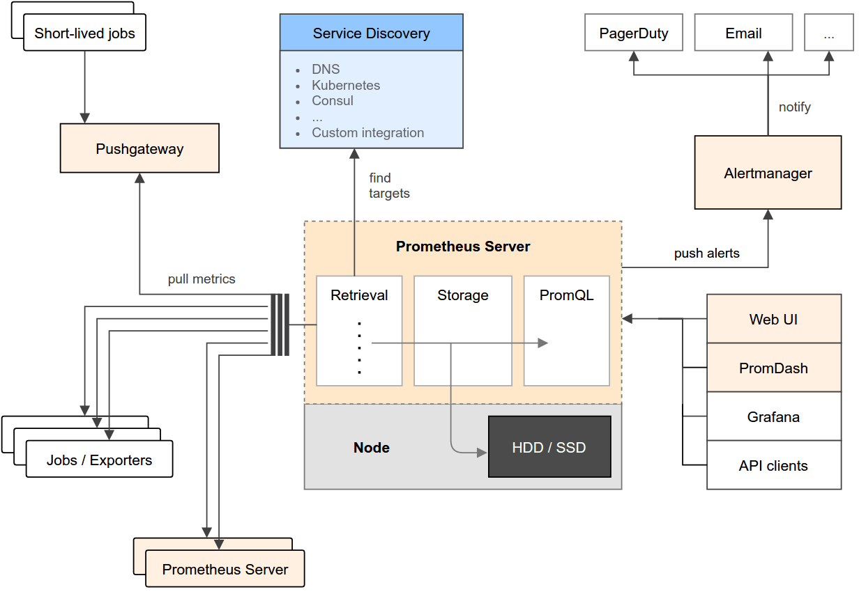
Prometheus server captures metrics from itself and from defined targets
It also has a push-gateway where jobs can push metrics to
PromQL (Prometheus query language)
lets the user select and aggregate time series data in real time
Has its own visualization tool, but more interesting is the Grafana support, in addition to the API
Alertmanager

Slide 3
Metric types
Counter
Example: number of requests, errors etc
Gauge
Incremental or decremental value that changes over time
Example: cpu usage, disk space
Histogram
Buckets, sum of all observations, count of all observations
Summary
Count, sum, quantile

Slide 4
Integration with Grafana
Easiest to get started: import a pre-defined dashboard
https://grafana.com/grafana/dashboards
Demo how to import and show the queries in Grafana

Slide 5
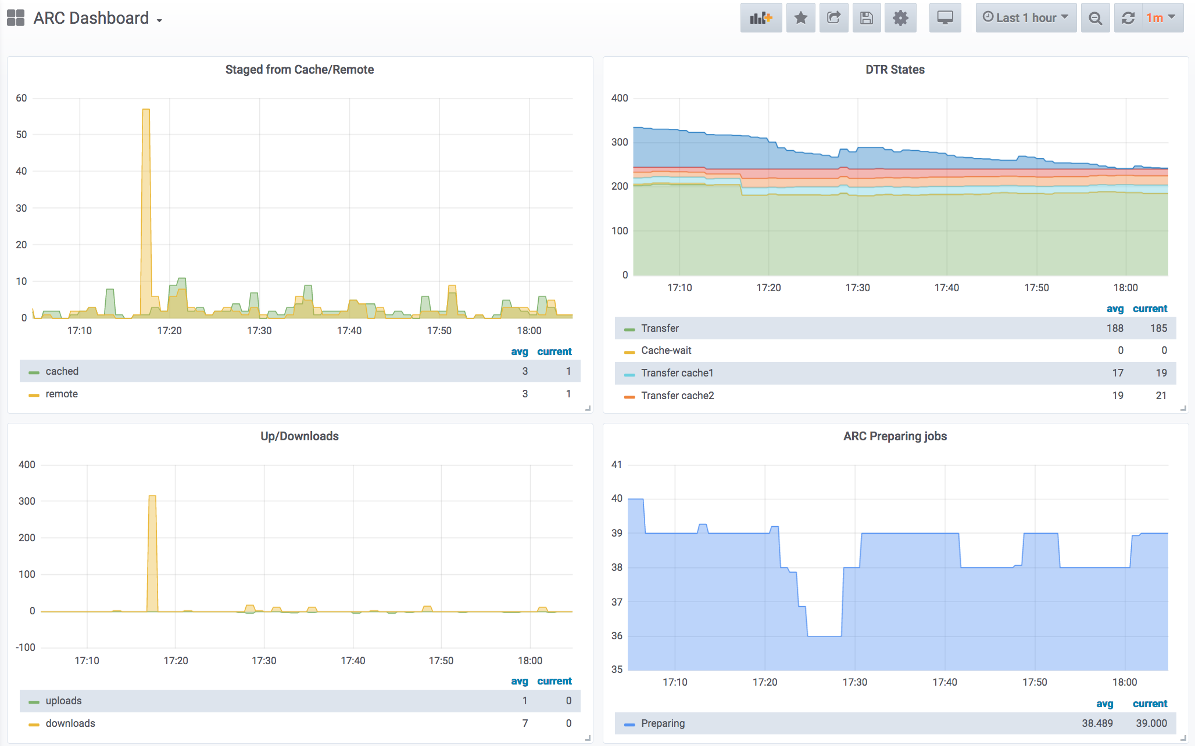

Slide 6
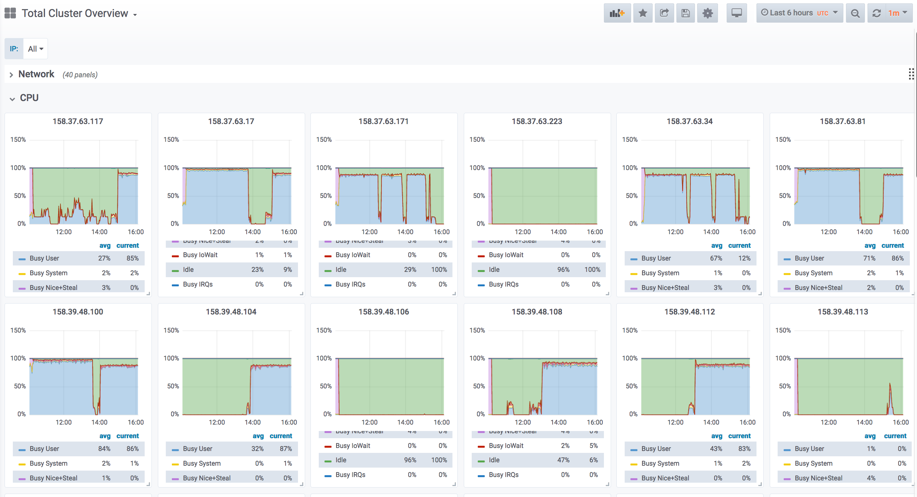

Slide 7
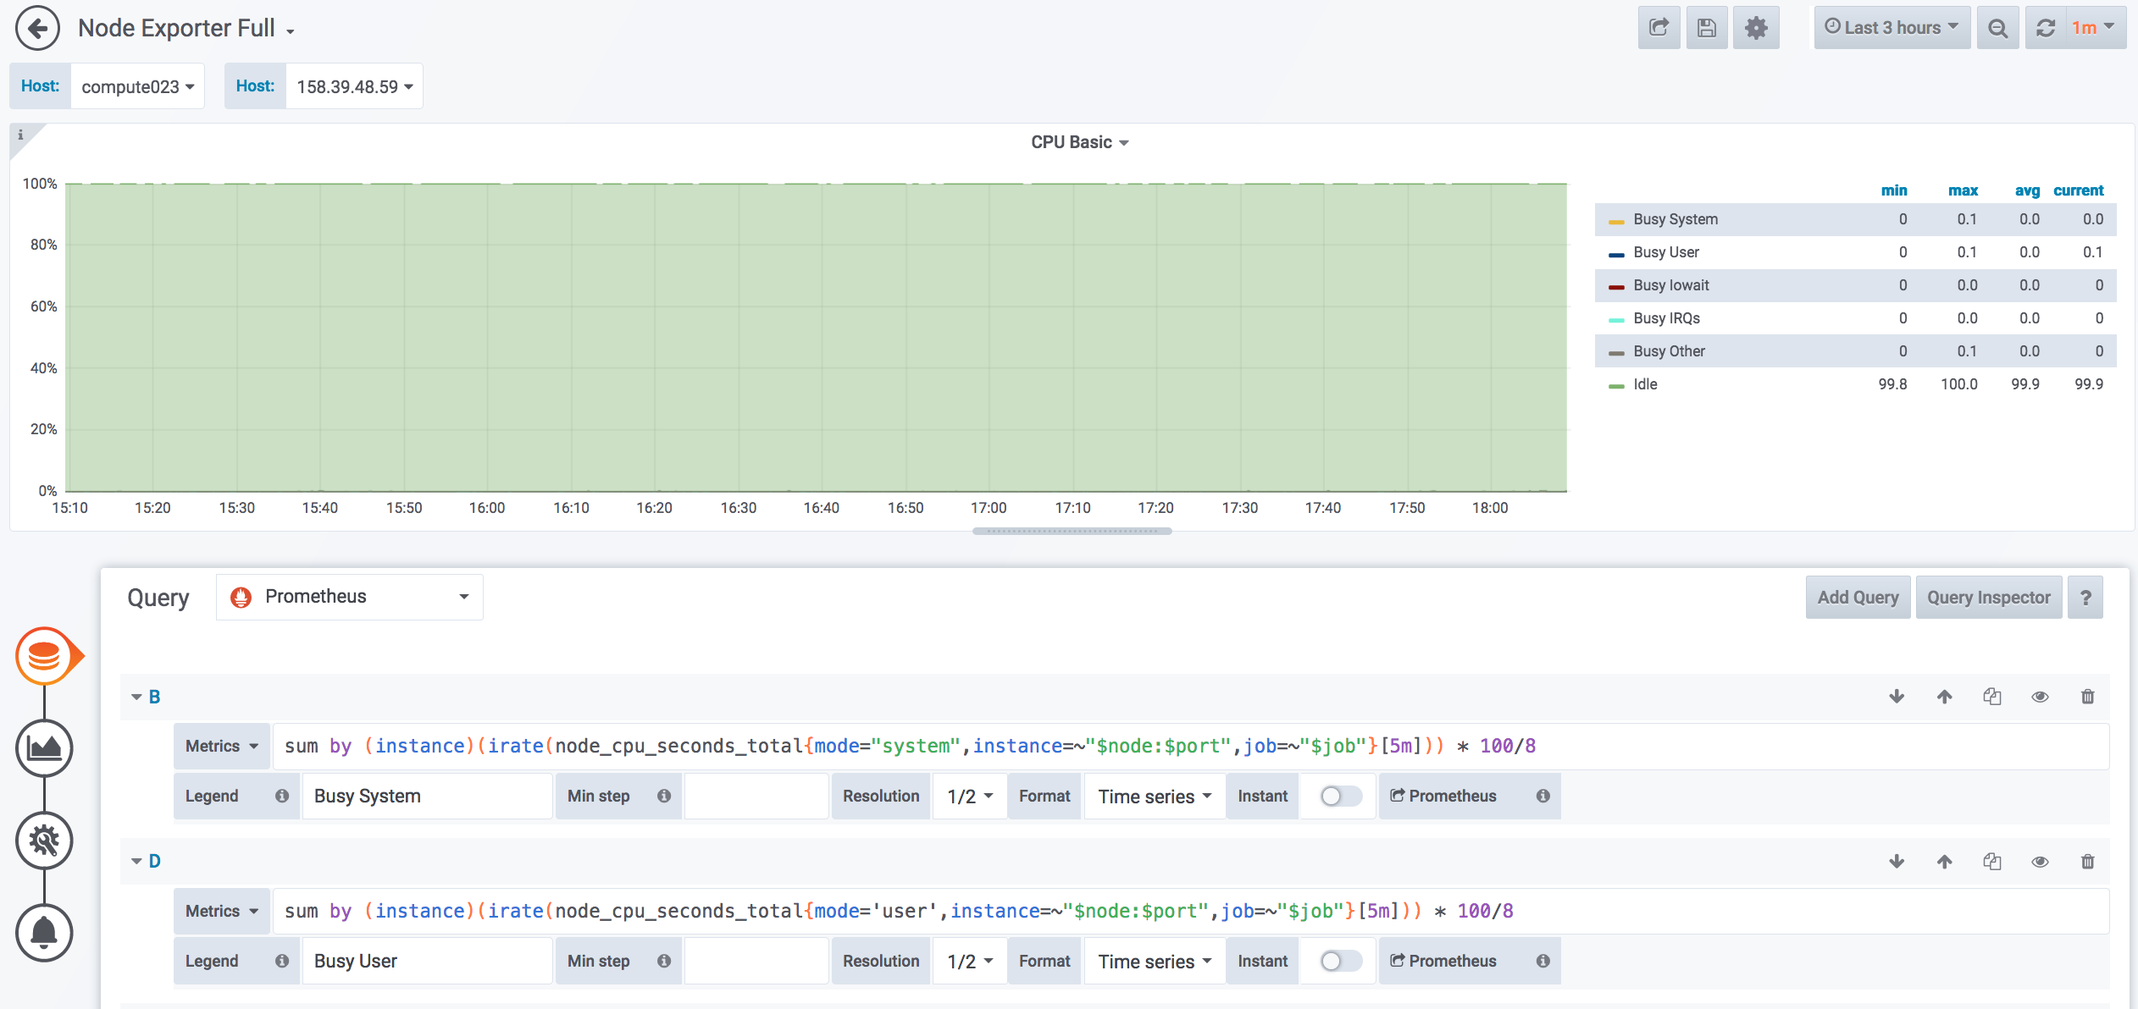

Slide 8
Security
Only the Grafana/Prometheus (grid-adm.grid.uiocloud.no) server to query the various Prometheus metrics endpoints

Slide 9
Example of metrics
Query from 158.39.48.46 curl 158.39.48.56:11000/metrics

Slide 10
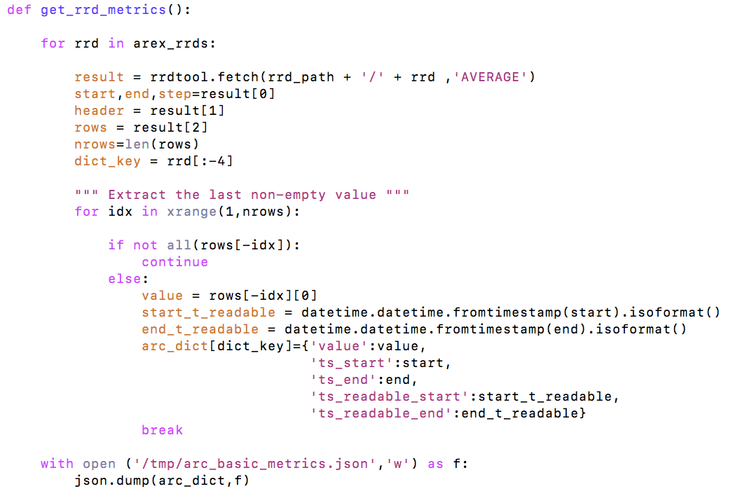
arc_rrd_tool.py
Metrics from ganglia
Assuming ganglia is running
Use the rrdtool: have set the arc_rrd_tool.py to run every minute by crontab
dumps a json file to be read by the Prometheus exporter
Wrote simple prometheus exporter for ARC that exposes the ARC metrics produced in the json

Slide 11
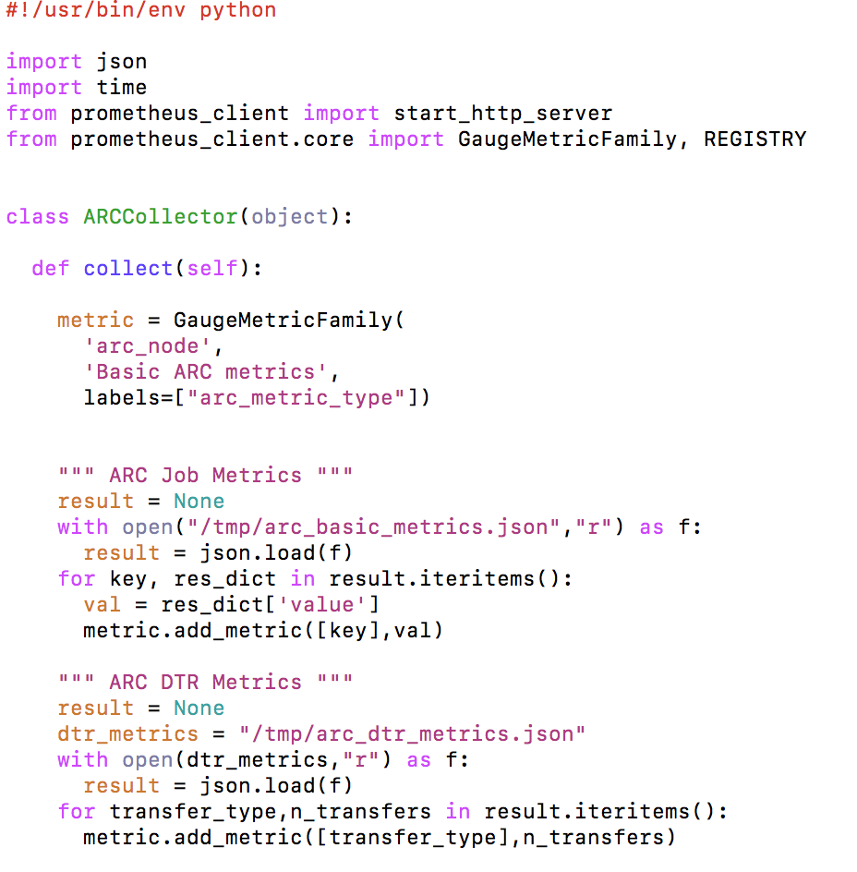
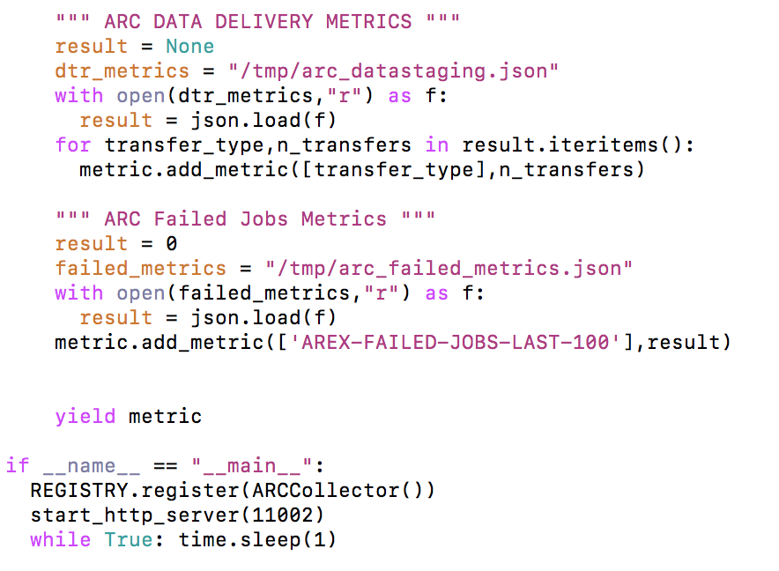
arc_exporter.py

Slide 12
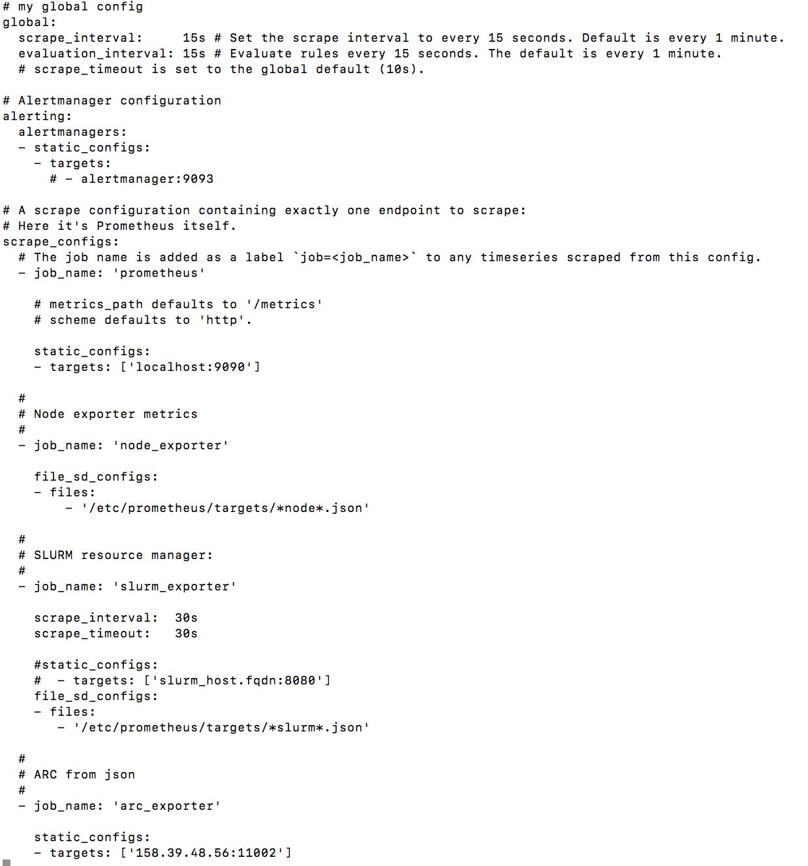
Configuration file prometheus.yml
Node_exporter
Slurm_exporter
Arc_exporter
w/DTR info
failed jobs per last 100
ganglia/AREX metrics

Slide 13
Links
https://prometheus.io/docs/prometheus/latest
https://grafana.com/grafana/dashboards
https://grafana.com/docs/
Ansible scripts for installing exporters:
NB! Disclaimer – in development and parts may have been changed and not tested!
https://source.coderefinery.org/maikenp/maiken/tree/master/grid-openstack-admin/playbooks

