Slide 1
Site report for UiO
NDGF All-hands meeting 22.10.2019
Maiken, Vincent, Darren

Slide 2
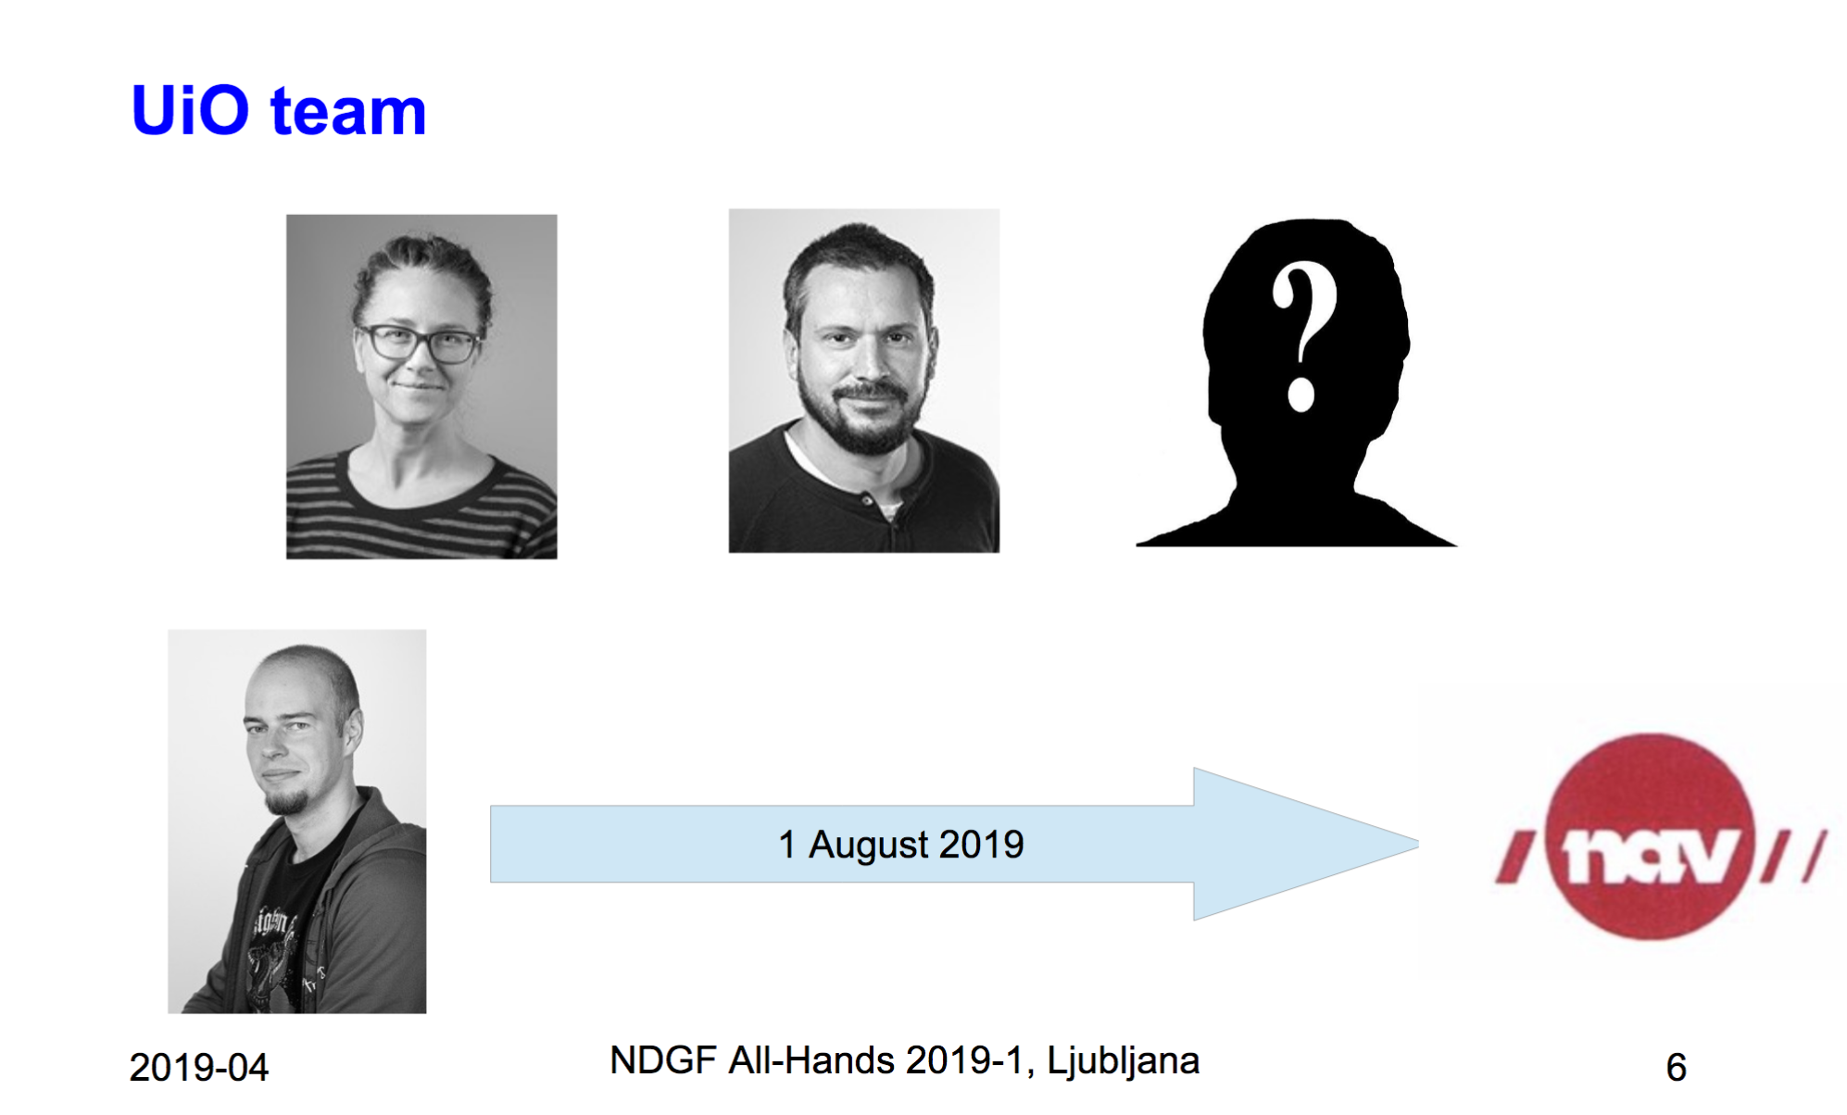
NDGF All-hands meeting April Ljubljana
Darren Starr

Slide 3
Tier 1 @ Oslo
Abel HPC is being decommissioned
ce01.grid.uio.no put out of service as of 15.09.2019
Low priority queue (ce03.grid.uio.no) is still going strong - will be running until Abel completely shuts off
Soon...
Plan to take out a rack, upgrade to Centos7 & run grid-jobs there …
Size: not sure yet

Slide 4
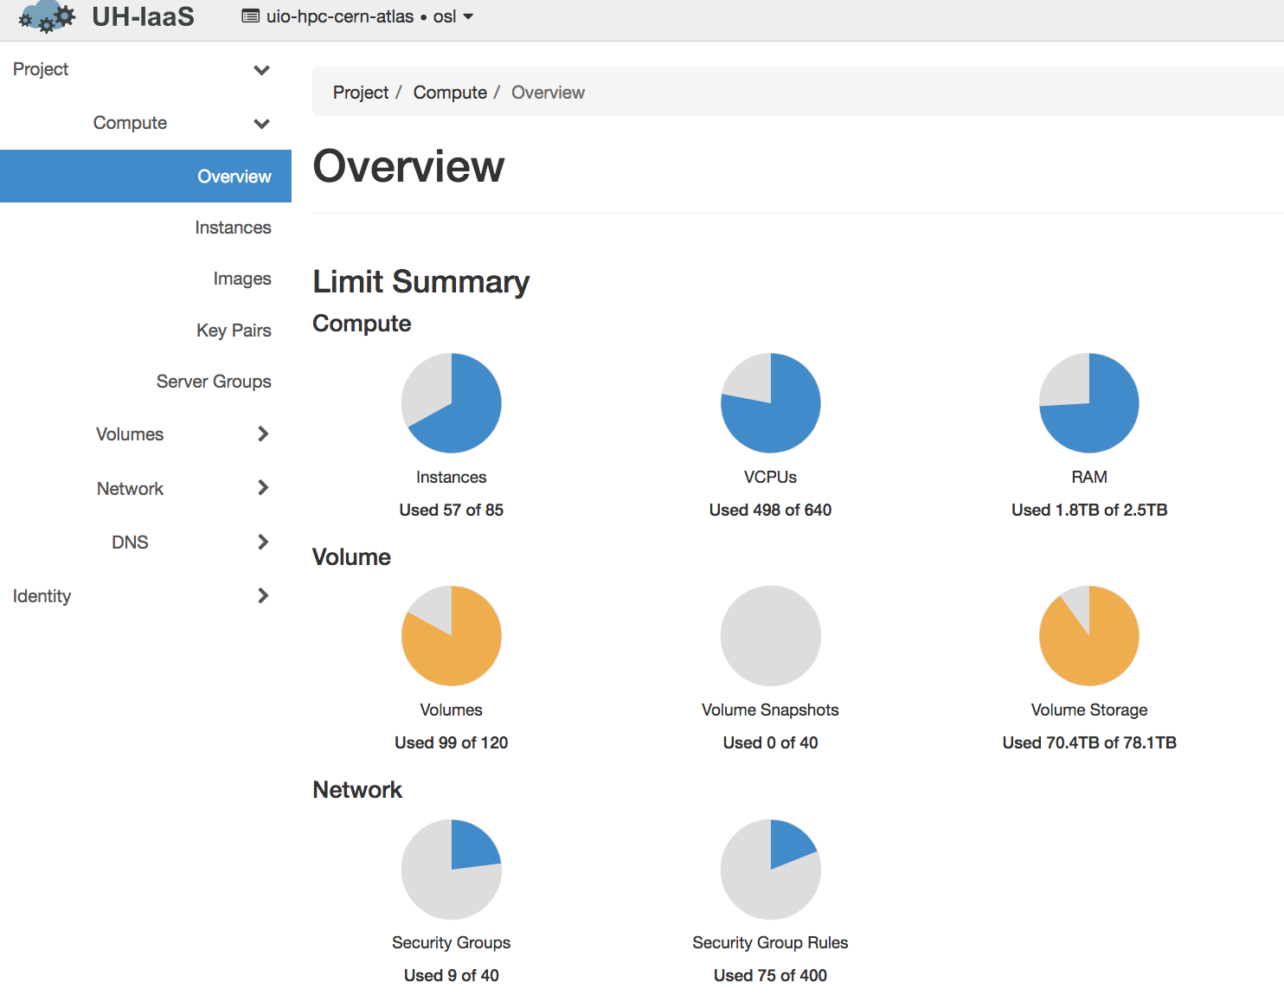
New Tier1: UIO_CLOUD - Grid on OpenStack @ UiO
Openstack AMD Epyc machines - HEPSPEC06 12.5 w/hyperthreading
~3.7GB RAM per vCPU
Instances with 8 vCPU’s
Size: 30 instances from ca June
Limited by disk - therefore running ARC in pilot mode
/scratch disk on each compute node - 200GB, 40 GB for cvmfs
pilots download data directly to /scratch/<arcjobid> directory
October: got some more disk, and eventually used it as ARC cache
Extended cluster with 10 instances
Wed 16.10: Switched to Nordugrid mode with ARC datadelivery service and ARC cache
20T x 3 ARC caches
3 Datadelivery host machines
More disk is available now
Extend cluster with 30 more instances (30*8vCPU=240 vCPUs) ⇒ Total vCPUS in cluster then 560
Possibly create more ARC datadelivery service hosts
More servers have arrived and will be installed in OpenStack
AMD Rome - 12 servers of 2(sockets)x2(threads)x48 cores - each with 512GB RAM ⇒ ~2.6 GB per thread after reserving some memory for the host
12x4x48=2304 vCPUs
⇒ Covers (more than) pledge (22.4kSpec/12.5=1792 cores)

Slide 5
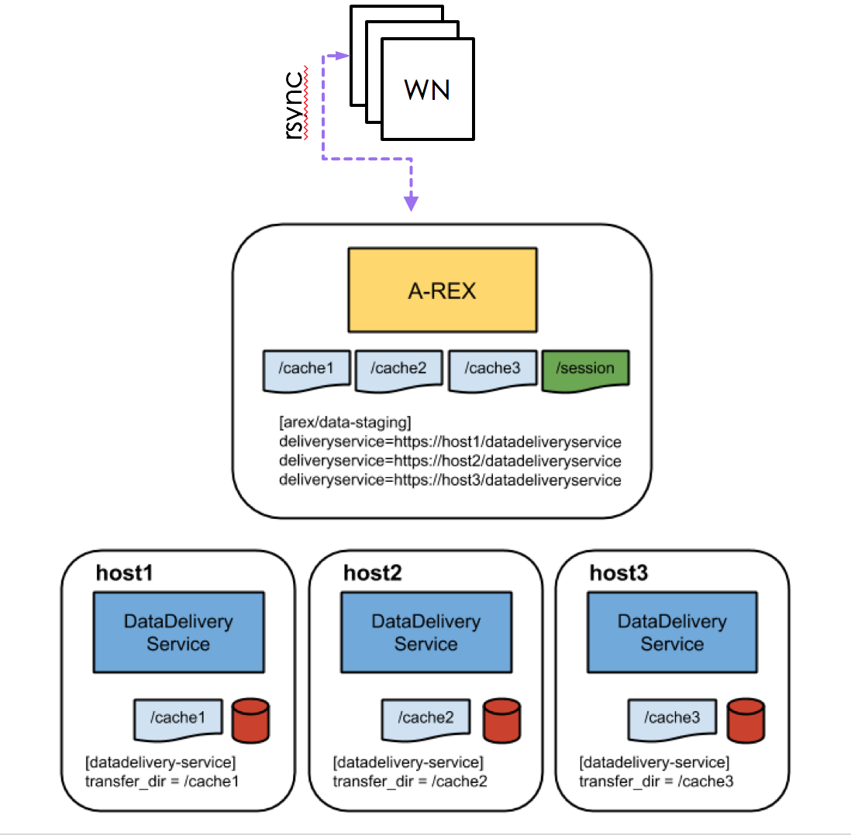
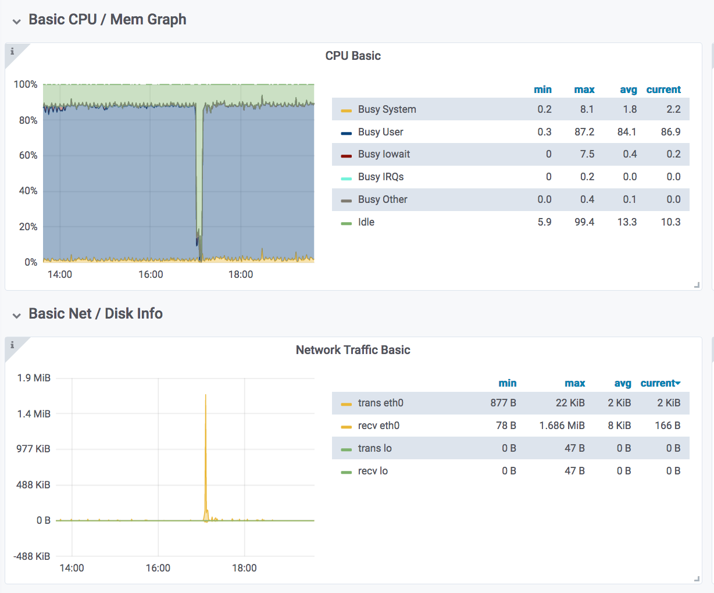
Current setup of UIO_CLOUD
Wanted to avoid having to NFS mount cache dirs to worker nodes
To get input data from ARC frontend sessiondir to workernode - rsync in submit_common.sh
rsync of 11 input files of 6.3GB each (~70 GB tot)

Slide 6
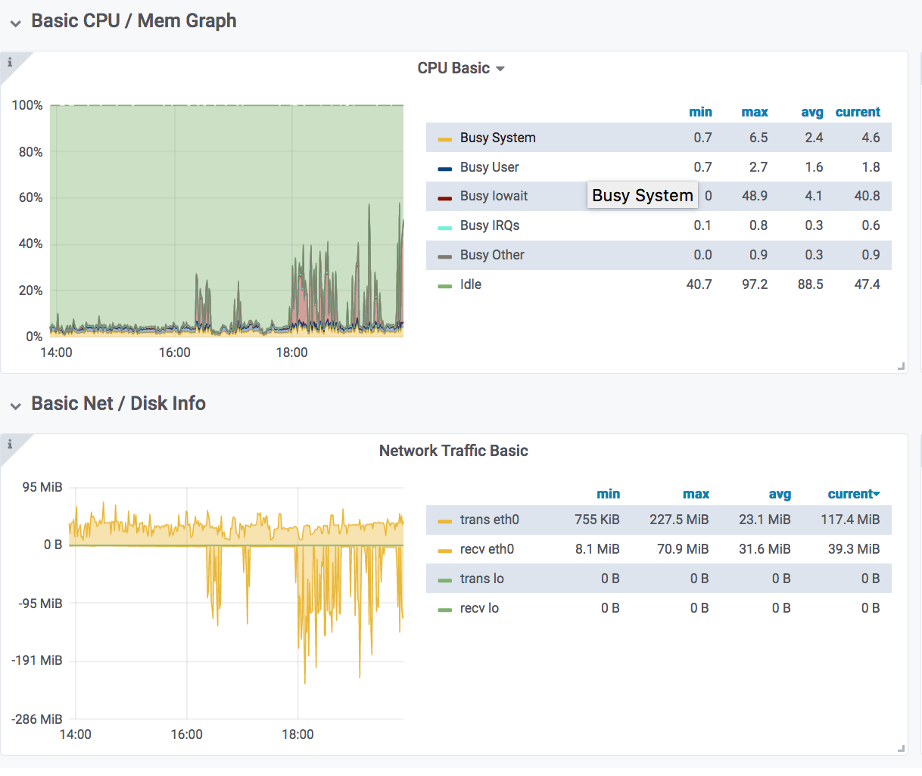
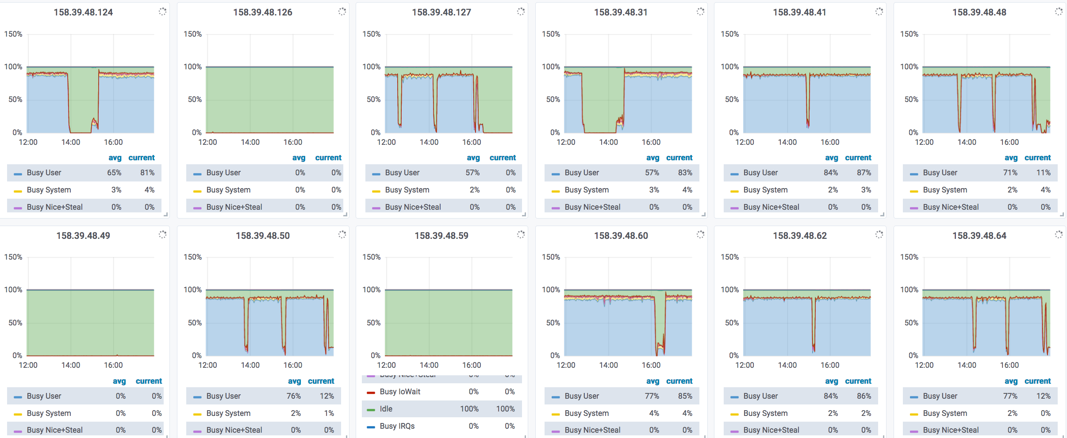
ARC Datastaging
Working on finding the optimal settings in order not to starve compute nodes
io-wait is an issue
how will scaling the cluster up go?

Slide 7
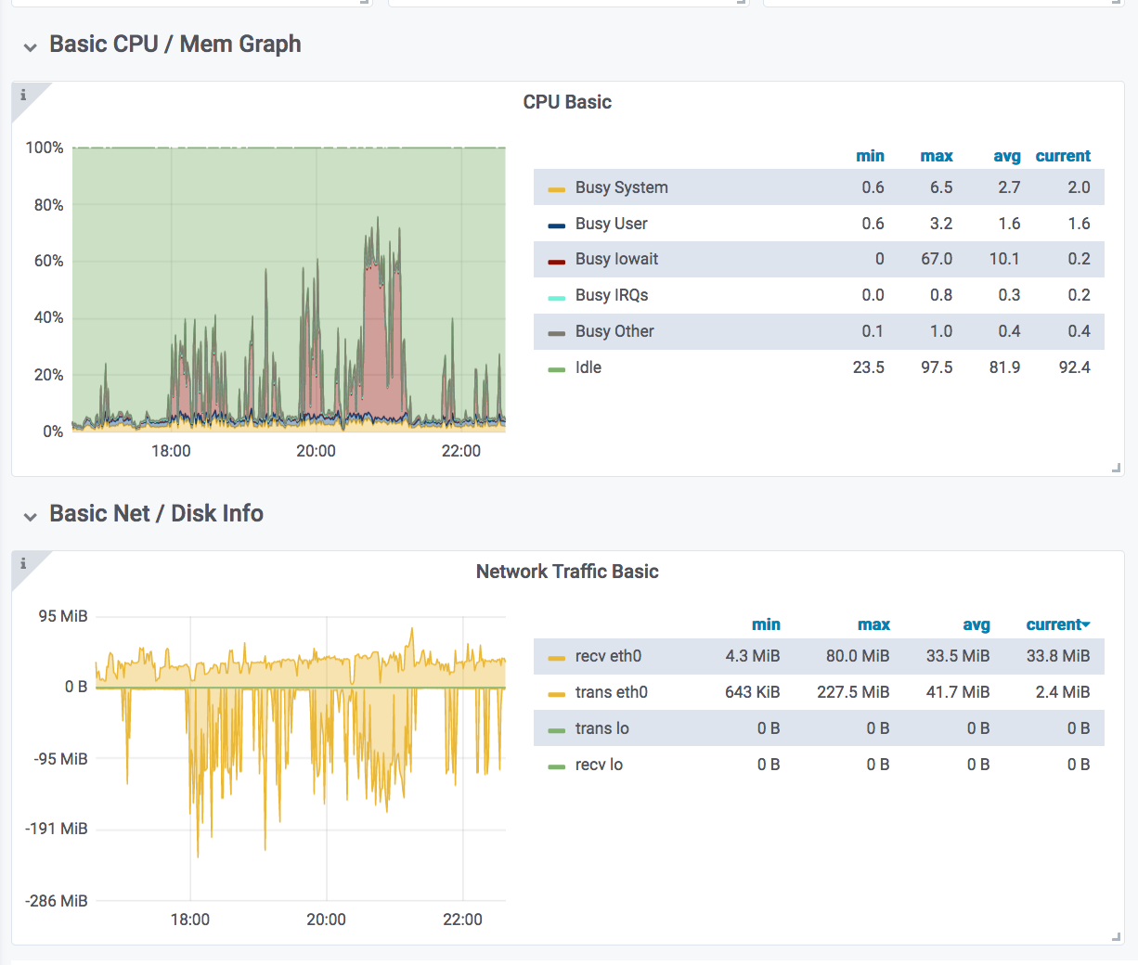
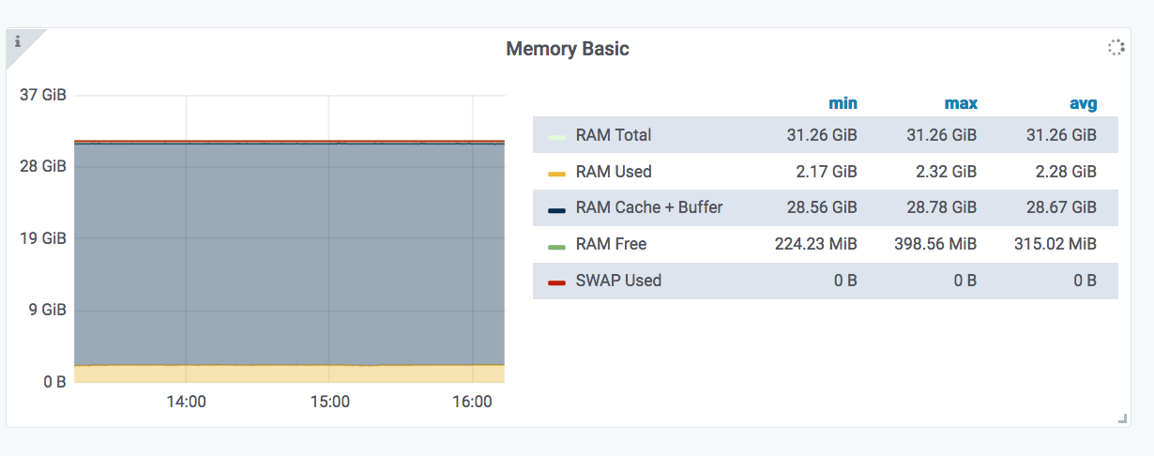
Datadelivery host
When there are a lot of reads in addition to writes, the IOWait rockets
RAM Cache+Buffer filled up

Slide 8
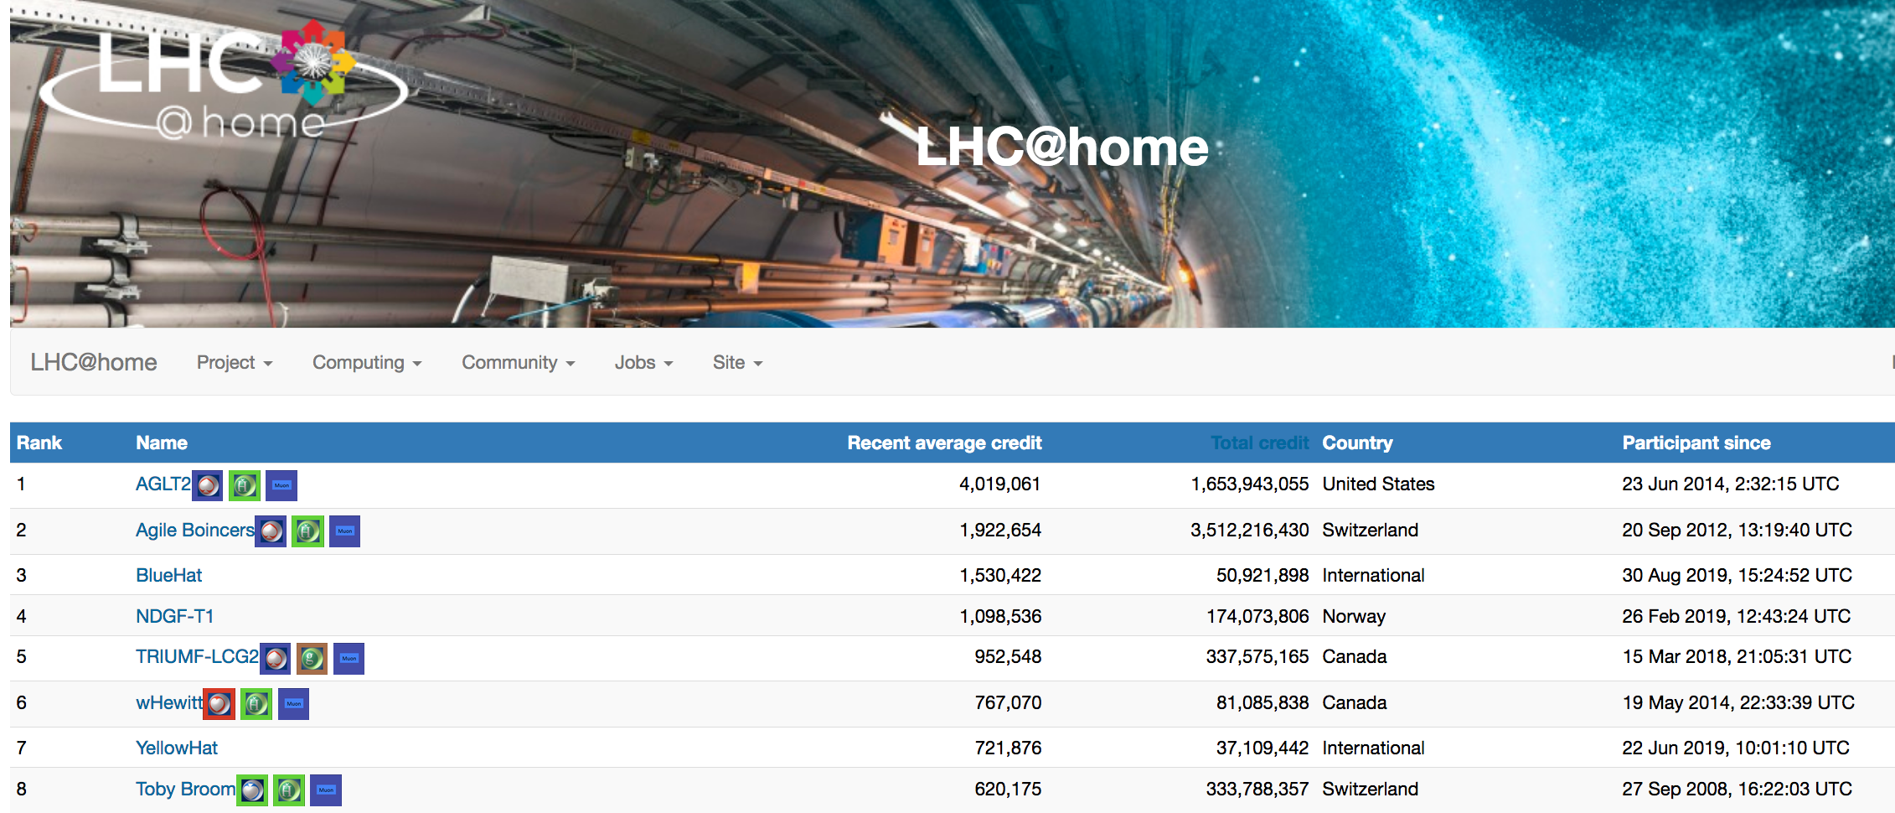
UiO@Oracle
Have been running for free in Oracle since before summer
UiO has an Oracle license which comes with CPU-hours which no one was using
Running boinc on these (Intel/AMD - 100 instances of 8 vCPUS)

Slide 9
Storage @ Oslo
Current dCache grid storage pools will be decommissioned in March 2020
The new dCache grid storage pools are on Ceph
2PB of available space
Erasure Code
New pools are being commissioned
Already in preproduction for local UiO physics group

Slide 10
Tape @ Oslo
Slides from last all-hands with tape and disk status: https://indico.neic.no/event/73/contributions/282/attachments/51/86/UiO_site_report.pdf

Slide 11
Extra....

Slide 12
Issues faced w/ OpenStack
Instances got killed due to lack of memory
Solved from OpenStack team by reserving more memory for the host after cpu/thread pair and pinning on Numa node
Jobs were using many times the max walltime set in the job description
Found out that if job asked for 8 cores, it started 10 athena.py processes where actually 9 were needing 100% cpu - caused extremely slow system
Solved by announcing only 7 cores per node to ATLAS - and actually running with 8 threads (lua plugin for SLURM)
The ARC frontend suddenly got corrupted after switching to ARC cache
Got overloaded since I had wrongly configured the datastaging machines - frontend was doing all the data staging
Luckily managed to take a snapshot of the instance and fire up a new one which is working w/o problems.
Things are more or less going well now :)

Slide 13
Some details OpenStack configuration
Instances get dedicated CPU and thread pairs which means that they then are pinned to one Numa-node
Hugepages on
16 GB memory reserved to the host - 496 available to the instances
Disk: block storage - volume service

Slide 14
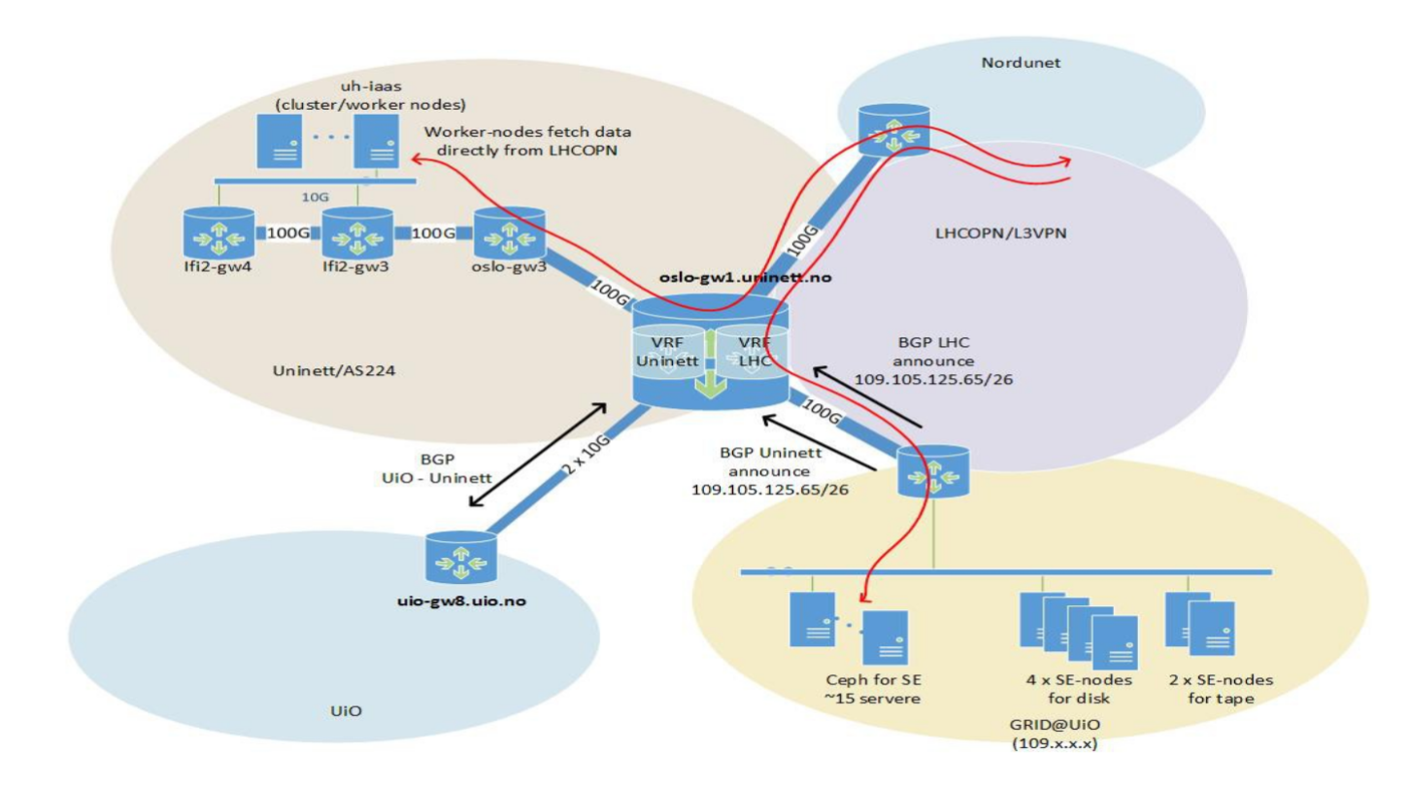
Network setup

Slide 15
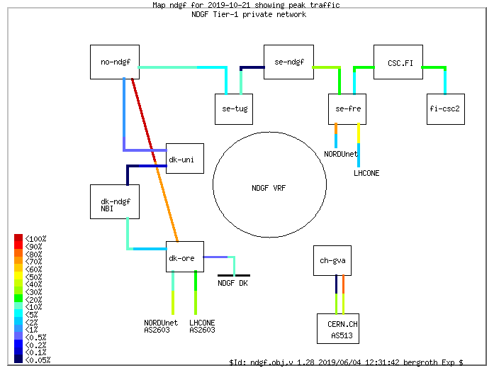
NorduNet load map

