Slide 1
Oslo site report
AHM 2024-1 - Copenhagen

Slide 2
All good and stable (large picture) in compute
Same setup as since 2020
Used up the budget for this period (as planned)
Thought we had service agreement on compute nodes end 2026 - but it turns out we do not. Either some miscommunication (although I got it confirmed several times) - or I do not know… Anyway we hope the hardware lasts until end of period
Plans: will recreate the cluster before summer going from centos 7 -> almalinux 9

Slide 3
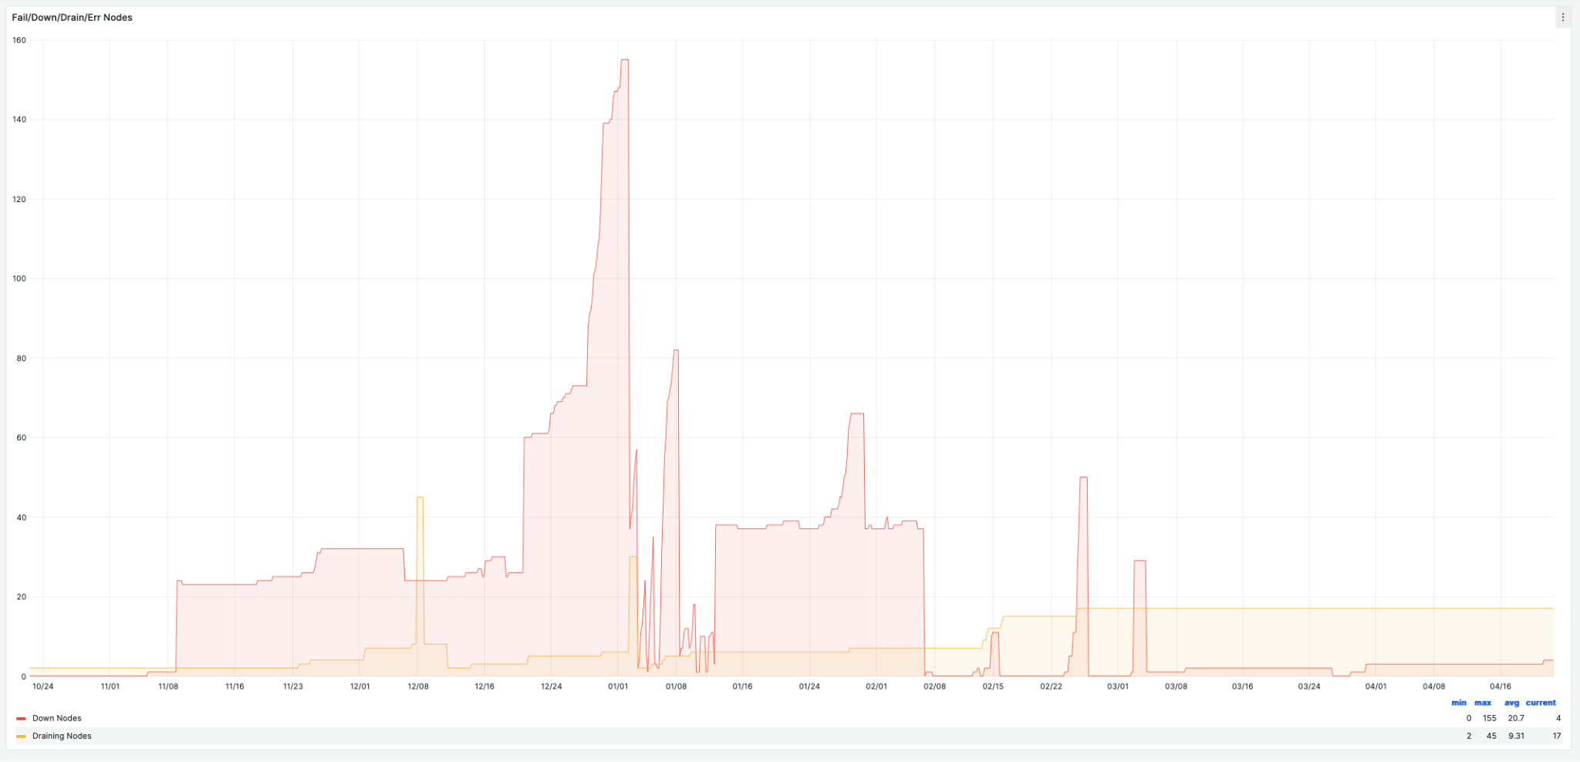
Compute
Been a somewhat bumpy ride since around Nov.
SLURM exporter
Red: Nodes down
Yellow: Nodes drain
November
April

Slide 4
Various issues causing low delivery
Had a period with lots of issues with iowait causing nodes to hang and go down in SLURM.
Some mitigations done on NREC side related to iops limit enforcement to prevent other iops hungry processes to clog the system. Also had my SLURM healthcheck script running for a while, think that worsened the situation. Off again.
Have finally noticed that some nodes are drained and stay drained in SLURM - not really sure why they do not get new jobs. Resumed them now.

Slide 5
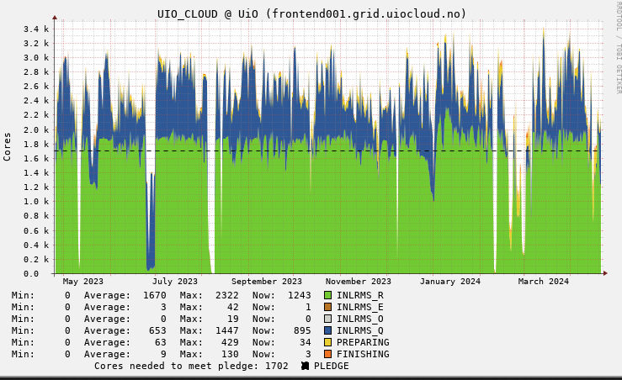
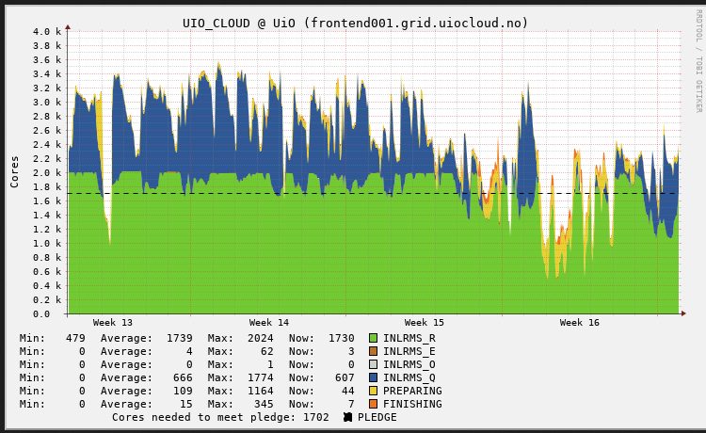
One year One month

Slide 6
Disk
New storage has been a “disaster” since installation.
Originally, we believed it was the storage. We learned it’s more likely the NICs.
We have started developing dCache on-site at UiO and have a face-to-face planned with Tigran 8-May to 10-May where he will help get a “on-device” development environment up to allow us to run non-destructive tests and profiling of new code.
We have improved write performance of dCache on early testing substantially by eliminating the idiotic 8KB transferred per system call limit imposed by Java.
Between Tigran and other DESY resources, we expect to get good enough performance for production soon.

Slide 7
Tape
WE HAVE TAPE!!! YES WE DO!!! 11PB (7PB OF LOVELY BRAND NEW TAPE!)
It looks like we’re finally not the bad guys.
The tape is filling and we’re happy!
Visiting a trade show in Berlin 7-May where I’ll look at Huawei 100-layer, BluRay 200TB disc system as an alternative supplier for archive storage.

Slide 8
Network
Things are moving slow on NAIC, but moving. Currently, we have 100Gb networking in the CERN rack. Adding redundancy (in rack, not Uninett), looking to upgrade to 400Gb

