Slide 1

CEDAR: Promoting FAIRness at the Source
Mark A. Musen, M.D., Ph.D
Stanford University
musen@stanford.edu

Slide 2
Systems to evaluate data FAIRness have had difficulty finding an audience
Scientists really don’t want a FAIR “report card”
No one wants to hear about problems with datasets that have already been uploaded to a repository
There is no fully computable solution to the question of whether a dataset is FAIR in the first place
Notes:
Fully

Slide 3
The FAIR Guiding Principles
  F1: (Meta) data are assigned globally unique and persistent identifiers
  F2: Data are described with rich metadata
  F3: Metadata clearly and explicitly include the identifier of the data they describe
  F4: (Meta)data are registered or indexed in a searchable resource
  A1: (Meta)data are retrievable by their identifier using a standardised communication protocol
  A1.1: The protocol is open, free and universally implementable
  A1.2: The protocol allows for an authentication and authorisation where necessary
  A2: Metadata should be accessible even when the data is no longer available
  I1: (Meta)data use a formal, accessible, shared, and broadly applicable language for knowledge representation
  I2: (Meta)data use vocabularies that follow the FAIR principles
  I3: (Meta)data include qualified references to other (meta)data
  R1: (Meta)data are richly described with a plurality of accurate and relevant attributes
  R1.1: (Meta)data are released with a clear and accessible data usage license
  R1.2: (Meta)data are associated with detailed provenance
  R1.3: (Meta)data meet domain-relevant community standards

Slide 4
Most FAIR principles are about metadata
  F1: (Meta) data are assigned globally unique and persistent identifiers
  F2: Data are described with rich metadata
  F3: Metadata clearly and explicitly include the identifier of the data they describe
  F4: (Meta)data are registered or indexed in a searchable resource
  A1: (Meta)data are retrievable by their identifier using a standardised communication protocol
  A1.1: The protocol is open, free and universally implementable
  A1.2: The protocol allows for an authentication and authorisation where necessary
  A2: Metadata should be accessible even when the data is no longer available
  I1: (Meta)data use a formal, accessible, shared, and broadly applicable language for knowledge representation
  I2: (Meta)data use vocabularies that follow the FAIR principles
  I3: (Meta)data include qualified references to other (meta)data
  R1: (Meta)data are richly described with a plurality of accurate and relevant attributes
  R1.1: (Meta)data are released with a clear and accessible data usage license
  R1.2: (Meta)data are associated with detailed provenance
  R1.3: (Meta)data meet domain-relevant community standards

Slide 5
Scientists have no direct control over repository infrastructure
  F1: (Meta) data are assigned globally unique and persistent identifiers
  F2: Data are described with rich metadata
  F3: Metadata clearly and explicitly include the identifier of the data they describe
  F4: (Meta)data are registered or indexed in a searchable resource
  A1: (Meta)data are retrievable by their identifier using a standardised communication protocol
  A1.1: The protocol is open, free and universally implementable
  A1.2: The protocol allows for an authentication and authorisation where necessary
  A2: Metadata should be accessible even when the data is no longer available
  I1: (Meta)data use a formal, accessible, shared, and broadly applicable language for knowledge representation
  I2: (Meta)data use vocabularies that follow the FAIR principles
  I3: (Meta)data include qualified references to other (meta)data
  R1: (Meta)data are richly described with a plurality of accurate and relevant attributes
  R1.1: (Meta)data are released with a clear and accessible data usage license
  R1.2: (Meta)data are associated with detailed provenance
  R1.3: (Meta)data meet domain-relevant community standards

Slide 6
FAIR principles depend on community standards that are not objectively computable
  F1: (Meta) data are assigned globally unique and persistent identifiers
  F2: Data are described with rich metadata
  F3: Metadata clearly and explicitly include the identifier of the data they describe
  F4: (Meta)data are registered or indexed in a searchable resource
  A1: (Meta)data are retrievable by their identifier using a standardised communication protocol
  A1.1: The protocol is open, free and universally implementable
  A1.2: The protocol allows for an authentication and authorisation where necessary
  A2: Metadata should be accessible even when the data is no longer available
  I1: (Meta)data use a formal, accessible, shared, and broadly applicable language for knowledge representation
  I2: (Meta)data use vocabularies that follow the FAIR principles
  I3: (Meta)data include qualified references to other (meta)data
  R1: (Meta)data are richly described with a plurality of accurate and relevant attributes
  R1.1: (Meta)data are released with a clear and accessible data usage license
  R1.2: (Meta)data are associated with detailed provenance
  R1.3: (Meta)data meet domain-relevant community standards

Slide 7
Metadata in public repositories are a mess!
Investigators view their work as publishing papers, not leaving a legacy of reusable data
Sponsors may require data sharing, but they do not encourage the use of grant funds to pay for it
Creating the metadata to describe data sets is unbearably hard

Slide 8
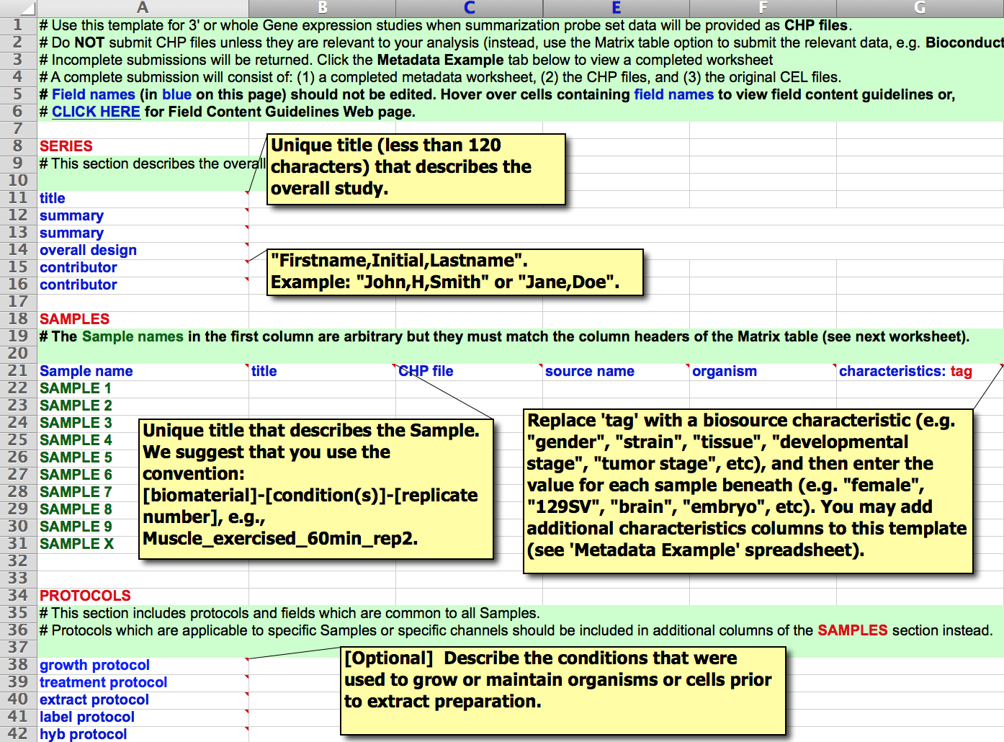

Slide 9
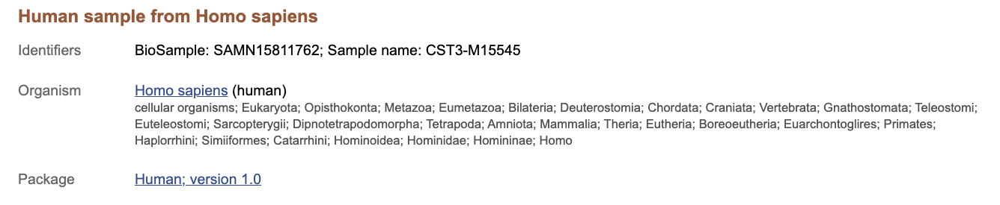
…
…
…
…
Full metadata record available at: https://www.ncbi.nlm.nih.gov/biosample/15811762

Slide 10
Metadata need to adhere to standards!
age
Age
AGE
`Age
age (after birth)
age (in years)
age (y)
age (year)
age (years)
Age (years)
Age (Years)
age (yr)
age (yr-old)
age (yrs)
Age (yrs)
age [y]
age [year]
age [years]
age in years
age of patient
Age of patient
age of subjects
age(years)
Age(years)
Age(yrs.)
Age, year
age, years
age, yrs
age.year
age_years

Slide 11
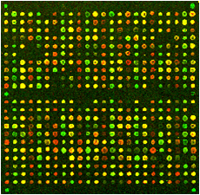
The microarray community took the lead in standardizing metadata reporting guidelines
What was the substrate of the experiment?
What array platform was used?
What were the experimental conditions?
DNA Microarray

Slide 13
But it didn’t stop with MIAME!
Minimal Information About T Cell Assays (MIATA)
Minimal Information Required in the Annotation of biochemical Models (MIRIAM)
MINImal MEtagemome Sequence analysis Standard (MINIMESS)
Minimal Information Specification For In Situ Hybridization and Immunohistochemistry Experiments (MISFISHIE)
These are exactly the kinds of community standards
that we need to structure metadata!

Slide 14
If we want to have FAIR data, we need good metadata. Good metadata need:
Ontologies to provide controlled terms
Reporting guidelines—like MIAME—to provide a standardized structure for the metadata components
Technology to make it easy to author good metadata in the first place
Procedures to create community-based standards in the first place
Notes:
need

Slide 15
  F1: (Meta) data are assigned globally unique and persistent identifiers
  F2: Data are described with rich metadata
  F3: Metadata clearly and explicitly include the identifier of the data they describe
  F4: (Meta)data are registered or indexed in a searchable resource
  A1: (Meta)data are retrievable by their identifier using a standardised communication protocol
  A1.1: The protocol is open, free and universally implementable
  A1.2: The protocol allows for an authentication and authorisation where necessary
  A2: Metadata should be accessible even when the data is no longer available
  I1: (Meta)data use a formal, accessible, shared, and broadly applicable language for knowledge representation
  I2: (Meta)data use vocabularies that follow the FAIR principles
  I3: (Meta)data include qualified references to other (meta)data
  R1: (Meta)data are richly described with a plurality of accurate and relevant attributes
  R1.1: (Meta)data are released with a clear and accessible data usage license
  R1.2: (Meta)data are associated with detailed provenance
  R1.3: (Meta)data meet domain-relevant community standards
Don’t even try to measure FAIRness.
Make data FAIR from the beginning!

Slide 16
Our approach in CEDAR
Encode standard, community-endorsed reporting guidelines as templates that offer fill-in-the-blank authoring opportunities
Use selections from ontologies whenever possible to provide standardized values for the template fields

Slide 17
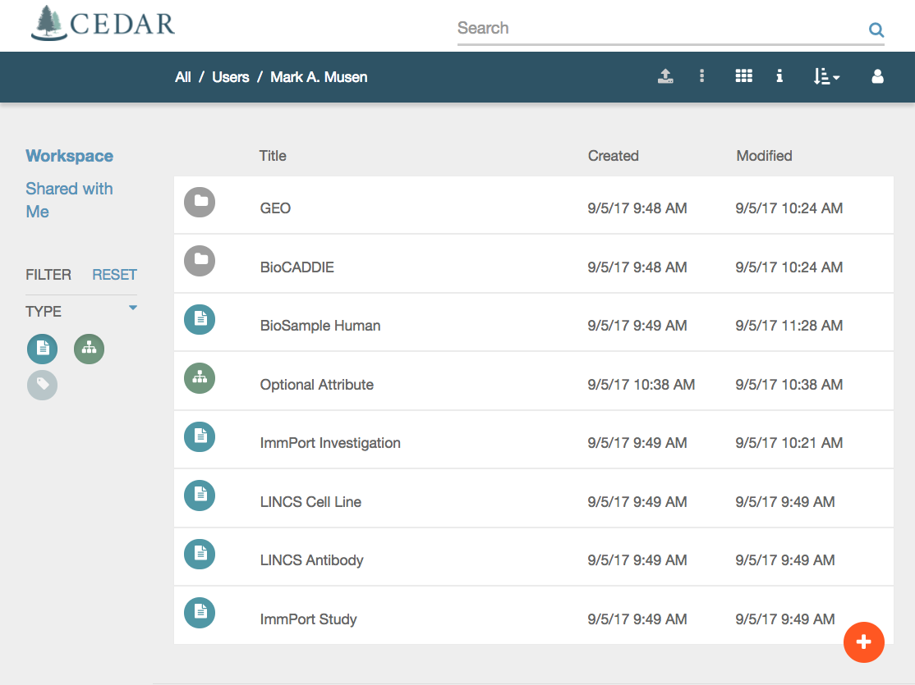

Slide 18
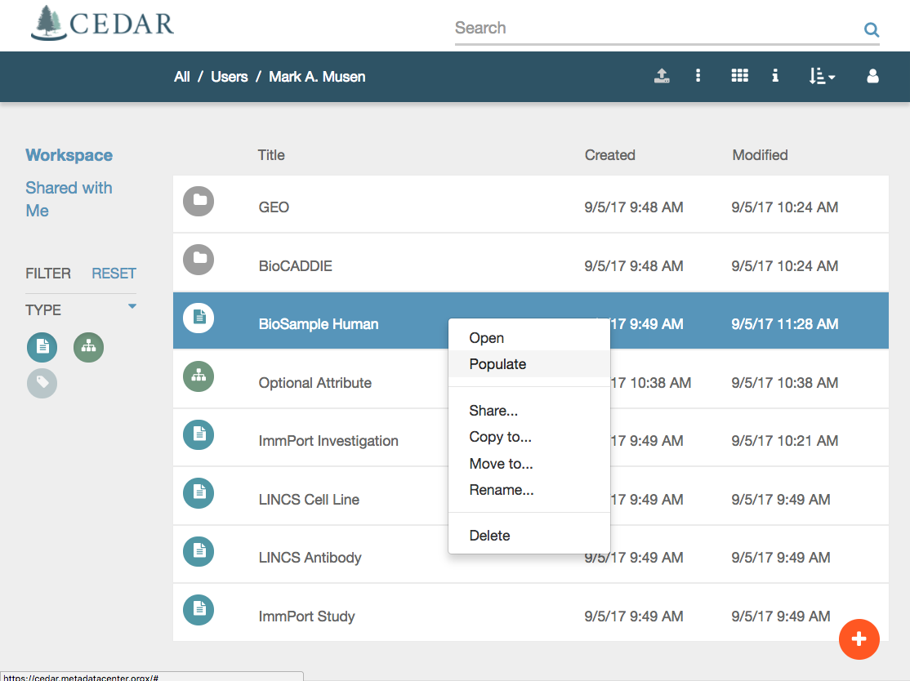


Slide 19
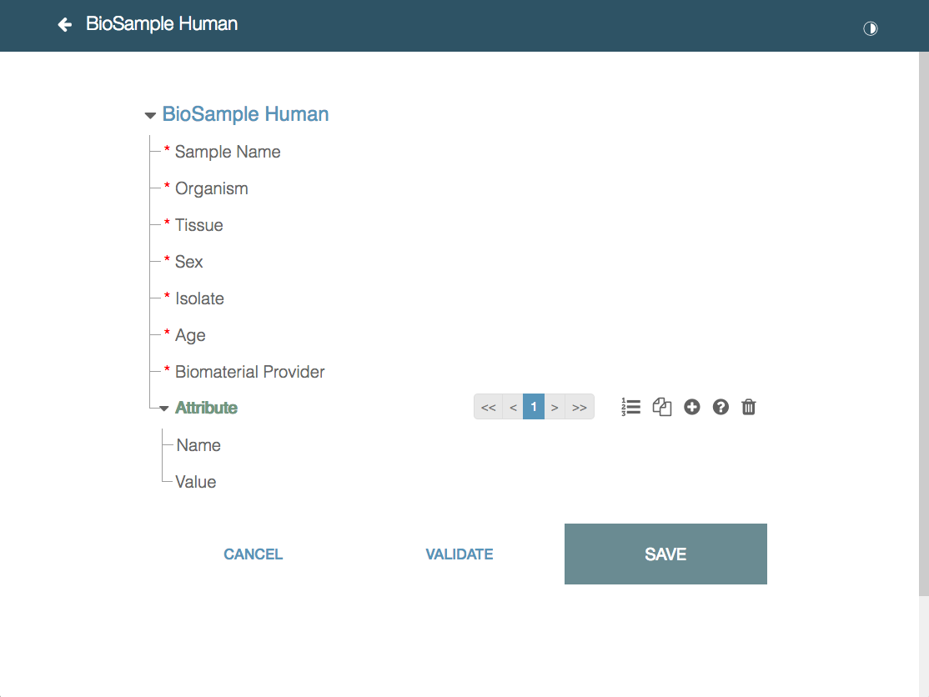
x
Notes:
Paged view

Slide 20
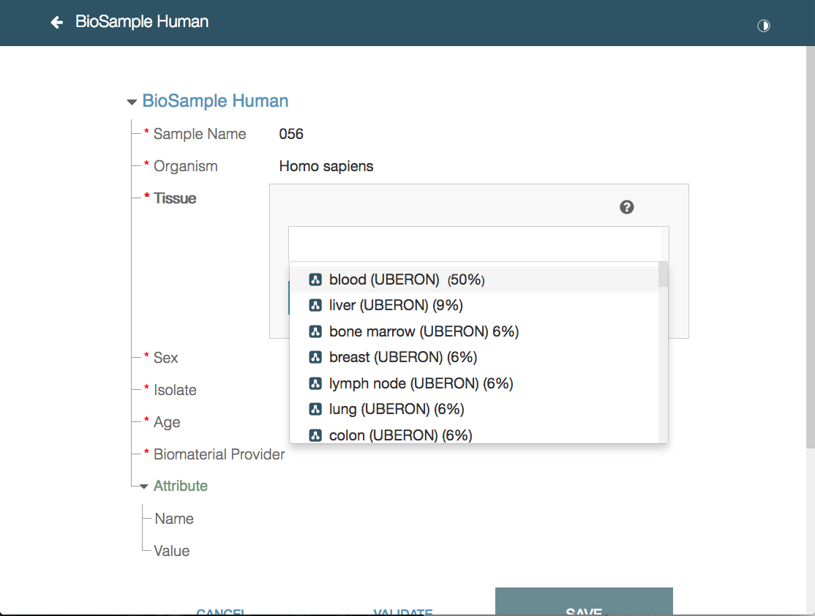

Slide 21
Projects that are adopting CEDAR
COVID research in the Netherlands
COVID research in the US (RADx)
Neurobiology research in the UK (VFB)
Tissue-mapping research in the US (HuBMAP)
Cell-signaling research in the US (LINCS)
Genomics research in the US (IDG)

Slide 22
If we want to have FAIR data, we need good metadata. Good metadata need:
Ontologies to provide controlled terms
Reporting guidelines—like MIAME—to provide a uniform structure
Technology to make it easy to author good metadata in the first place
Procedures to create community-based standards in the first place

Slide 23

Metadata for Machines Workshops
Are intensive 1–3 day invited, highly participatory sessions
Historically, have been hosted by GO FAIR Organization
Lead groups of scientists to consensus regarding essential metadata fields
  for different areas of science
  for different kinds of experiments
Ultimately result in new CEDAR metadata templates

Slide 24

Online data will never be FAIR
Until we standardize metadata structure using common templates
Until we can fill in those templates with controlled terms whenever possible
Until we create technology that will make it easy for investigators to annotate their datasets in standardized, searchable ways
Until we recognize the importance of creating FAIR data
from the very beginning

