Slide 1
State of ARC
Maiken Pedersen On behalf of the ARC development team
NDGF AHM 2021-1

Slide 2
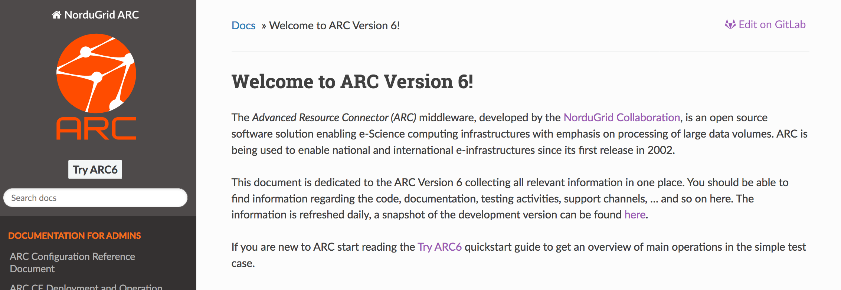
ARC development focus last years

Slide 3
Release strategy
Scheduled ~bi-monthly releases
All commits except backward incompatible changes are committed directly to master
No clear distinction between a bugfix and minor release (change to previous)
We inform in the release notes when there are changes other than trivial bugfixes
All scheduled releases are numbered X.Y.0 (e.g. 6.4.0)
If an emergency/express release is necessary due to an important security patch or a blocker bug – release is numbered X.Y.Z where Z != 0 (e.g. 6.10.1)
No “golden release” → no patching of earlier releases (except security patches of last major release, see later)
Backward incompatible changes are released in a major release (e.g. 7.0.0)
Major releases occur between 1-3 years
Only nordugrid-arc released with an ARC release – no more release bundle (no docs, nagios, gangliarc)
🡪 Release name changed from year.month.u.# to ARC 6.0.0
ARC nagios plugin still present in nordugrid repo, but follows its own release cycle, maintaned by Petter Urkedal (NBI). https://source.coderefinery.org/nordugrid/arc-nagios-plugins
http://www.nordugrid.org/arc/arc6/misc/release_management.html
History of releases: http://www.nordugrid.org/arc/releases/

Slide 4
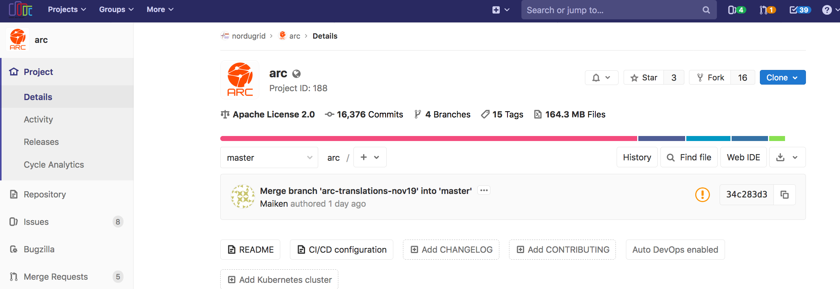
ARC on GitLab and GitHub
https://source.coderefinery.org/nordugrid/arc
Mirrored at https://github.com/nordugrid/arc
We can receive pull-requests here, they are then automatically copied to Gitlab for further processing
Nightly builds for all supported platforms on http://builds.nordugrid.org/nordugrid-arc/master/ Getting the packages
Nordugrid repository: http://download.nordugrid.org/repos/6/
Debian, EPEL
UMD (EGI software repo - Unified Middleware Distribution) release: https://wiki.egi.eu/wiki/UMD_Release_Schedule

Slide 5
Ongoing developments for ARC 6 APEL ActiveMQ 🡪 ARGO MS
EGI running campaign of migration from ActiveMQ message brokers to ARGO messaging service → APEL publisher switches to ARGO
ARC changes are ready for testing: https://source.coderefinery.org/nordugrid/arc/-/merge_requests/1168
Scheduled for release before APEL moves to ARGO which is end of May
Need testing done well before that!
If not we will have to ask for another extension

Slide 6
Ongoing developments for ARC 6-7 Tokens
Ongoing work
Prototype in place since ARC 6.6: http://www.nordugrid.org/documents/arc6/misc/oidc_tokens.html
Workshop in June for sorting out requirements
We will attend
Hopefully delegation requirements will be fixed then

Slide 7
Ongoing developments for ARC 6 REST interface
Implemented in 6.9.0
Simplification of WS interfaces - skips all SOAP related things , HTTP based REST
Can be used with simple clients based on something like curl for example
Easy to integrate into third-party clients which do not want to adopt ARC library
Currently being tested
Tested and working in aCT
A couple of minor client bugs which will be fixed in 6.12
http://www.nordugrid.org/documents/arc6/tech/rest/rest.html

Slide 8
ARC 7
No dedicated effort as of yet → release probably not before 2022
Issue for tracking plans or wishes for release: https://source.coderefinery.org/nordugrid/arc/-/issues/84

Slide 9
Development plans for ARC 7 (or 7++)
Dream?
LRMS-less ARC: an ARC CE that can be deployed directly on top of set of dedicated resources
Autonomous ARC?
Need client-developer!
NeIC Open Call 2021 – hope for ARC+Galaxy development project
Submit jobs to HPC via Galaxy and ARC
Following the technological development
Support of token-based security layer
Going towards container orchestrators
So far via RTE’s – jobs can be run in docker or singularity containers
We support docker for htcondor
Singularity
NEW ARC deployment mechanisms: ARC installation via containers
DATA subsystem scalability improvements
Controldir scalability improvements
Phasing out of gridftp/ldap
HTCondor support for REST there will be no need for them anymore
Always ongoing: improving code-base for scalability and stability
Notes:
Fully autonomous car

Slide 10
Wishes for ARC 7?

Slide 11
Conclusion
Day-to-day business for ARC
Not yet much focus on ARC 7, but will come…
Crossing fingers for NeIC project!

