Slide 1
UIO - site report
AHM 2021-1
Darren, Maiken, Vincent

Slide 2
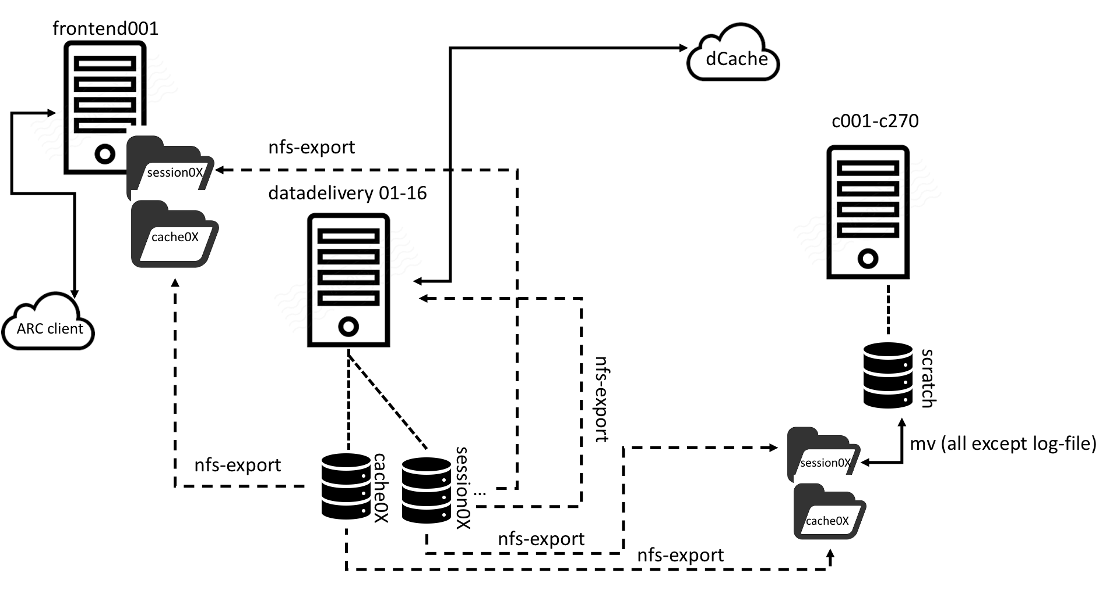
Compute
Current (and final) setup
270 compute nodes x 8 cores AMD Rome Epyc 14.98 HEPSPEC/cpu SLURM 25 GigE link between nodes
16 remote datadelivery servers 10TB cache on each server 100G session on each server 100 GB scratch disk on each compute All disks are now ssd
- sessiondir, nfs exported to compute, frontend, other datadelivery servers - cachdir, nfs exported to frontend, compute
frontend does neither input datastaging nor output datastaging - to offload ARC-CE as much as possible
Lowpri jobs (simulation) pre-emteable. Fills up cluster if datastaging is not fast enough for MCORE jobs.

Slide 3
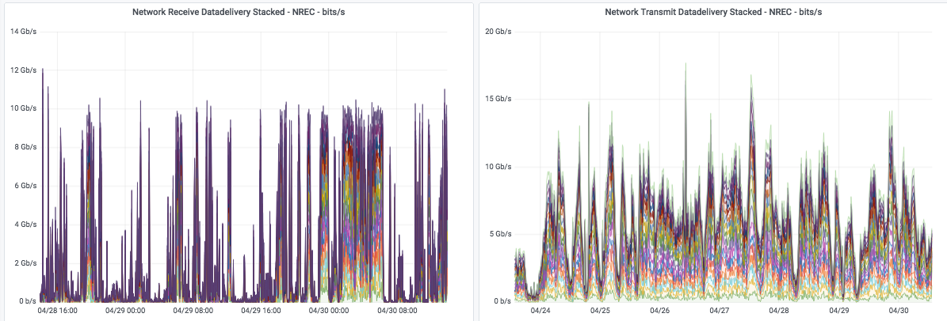
Typical data throughput
Just as a snapshot of situation, no evaluation if this is good or bad.

Slide 4
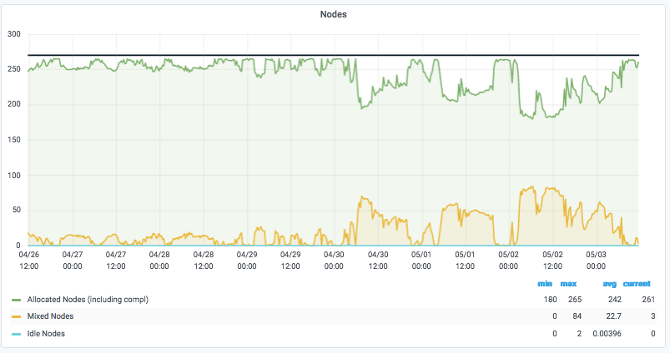
Fill status

Slide 5
Running jobs per partition (queue)

Slide 6
arc.conf for scratch
shared_filesystem=yes
scratchdir=/scratch
No SCRATCHDIR RTE used as ARC and not LRMS constructs scratchdir path
/scratch/<arc-jobid>

Slide 7
Disk
Current and final setup
11 nodes Huawei ARM servers (64-core, 128GB)
26x8TB disks configured in RAID60 for 163TiB each
1.793PiB Aggregate
Single 10GbE per node
There is an availability of an additional 79.2TiB on the nodes currently unconfigured and used for testing purposes.
ceph-osd(01-11).grid.uio.no
ceph-mgmt01.grid.uio.no

Slide 8
Disk - Future plans
Rather than waiting until the last minute to slap together a design specification, following configuration of our new tape system, we’ll initiate internal research to build a new set of disk pools based on a distributed storage mechanism that will eliminate downtimes during OS updates.

Slide 9
Tape
Current and soon to be replaced
Please refer to last year’s configuration for more details. All hardware in this configuration is in a rapidly scheduled replacement cycle. It should all have been decommissioned in January.
IBM Tape array
se0[56].grid.uio.no
TSM server

Slide 10
Tape
Being configured or procured
Tape Pool Nodes
2xDell PowerEdge R7525 (16 cores, 64GB) 12.8TB Mixed use SSD per node in RAID5 100GbE Mellanox ConnectX-6 RHEL 8.1
TSM Server
Still gathering details (it’s in the rack) 100GbE Network 32GbFC Storage connectivity
Tape Array
We’ve released a tender, we haven’t finalized procurement yet. We specified Jaguar drives and high specification
I’m not positive of capacity, but it’s been specced to meet requirements exceeding those recommended by Mattias
Jaguar based tape array
dcache-tapepool-0[12]grid.uio.no
TSM server

