Slide 1
Swedish Research Council and national coordination of open access to research data Sanja Halling 2019-05-16

Slide 2
National coordination of open access to research data
The Swedish Government assigned specific national coordination responsibility to the Swedish Research Council on coordinating Sweden’s work on introducing open access to research data. The aim is to complete the transition no later than 2026.
a policy leader on issues relating to open access to research data, for example guidelines and incentives
contribute to and facilitate - data management and FAIR
focus on the entire data management cycle,
collaboration both on national and international level
in close collaboration with the research communities

Slide 3
Open data in research
Open data is data that is freely available, and can be used and re-used.
Open access to research data means that data collected and/or created during the course of research shall be published with free access via internet. Research data with open access that even can be used and re-used is open research data.
”As open as possible, as closed as necessary”.
Flickr, justgrimes, ”open data (scrabble)”, CC-BY-SA 2.0.

Slide 4
OPEN ACCESS TO PUBLICATIONS
OPEN DATA
PUBLIC SECTOR INFORMATION - PSI
OPEN RESEARCH DATA
OPEN (PSI) DATA
OPEN ACCESS
RESEARCH DATA, ACCESS
CLOSED RESEARCH DATA
REGISTER BASED RESEARCH
CLOSED PSI DATA

Slide 5
Eco-system connected to open access to research data - Sweden
National assignements and actors.
Steering group
VR
Register based research
Reference group
URFI
VR
Open Science
Higher education institutions
VR Open Access
Research data
SUHF
SUNET
National Archives
SND
DHP
National Library Open access
Publications
VR
Criteria for FAIR research data
SweCRIS
SNIC
KB
Criteria for FAIR publications
DIGG
Open data (PSI)
Hack for Sweden
Working group
Specific research infrastructures, for example Clarin, CESSDA, ELIXIR, etc.

Slide 6
Eco-system connected to open access to research data – nordic, European, international initiatives and activities
Open Science
GÉANT
NOS
NordForsk
EOSC
PRACE
OpenAIRE
NOSC
PSI
NEIC
EUDAT
NORDUnet
Science Europe
VR Open Access
Research Data
RDA
eIRG
FAIR data expert group
OECD
VR
Criteria for FAIR research data
G8
euroCRIS
EGI

Slide 7
European perspective
The Swedish Research Council is the national point of reference for open access (NPR). The European Commission has issued a recommendation on access to research data and preservation of scientific information. The Swedish Research Council is NPR, coordinating the measures stated in the recommendation nationally and report on the work done in Sweden to the European Commission – and vice versa.
European Open Science Cloud, EOSC, is an initiative from the European Commission for a joint, open and virtual environment for supplying services for storage, management, sharing, analysis and use of research data. The initiative is based on the vision of an open and accessible innovation and science society – in Europe and globally. Among the stakeholders are researchers and research networks, but also research infrastructures, research funding bodies, service providers, higher education institutions and other institutions.

Slide 8
Data management and FAIR
criteria for each one of the 15 FAIR principles
guidance for compliance
FAIR is supporting good data management.
FAIR (Findable, Accessible, Interoperable och Reusable).
Criteria for FAIR research data
In 2017, the Swedish Research Council received an assignment from the Government to produce criteria for assessing how research data that have wholly or partly been produced using public funds fulfil the FAIR principles. The criteria we have produced can also be used to support researchers in their planning and conduct of research and data management according to FAIR.

Slide 9
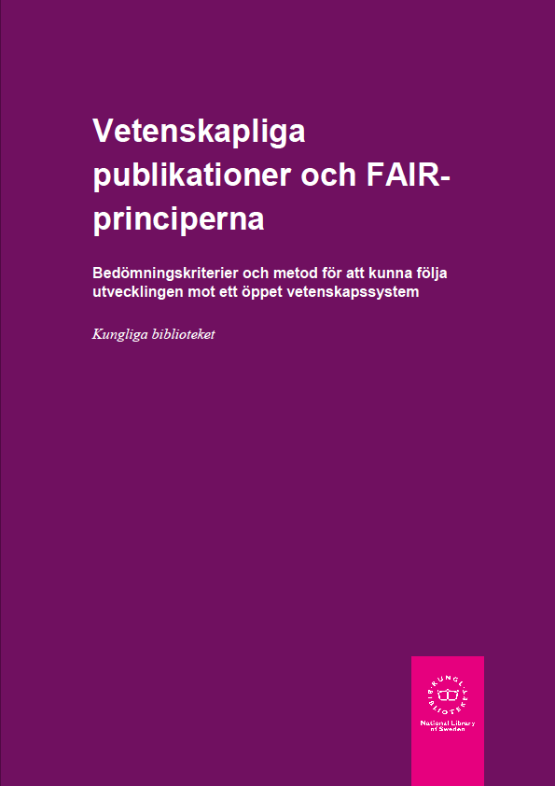
FAIR-criteria
Reports from the Swedish Research Council and the National Library.
CC-BY, Kungliga biblioteket.

Slide 10
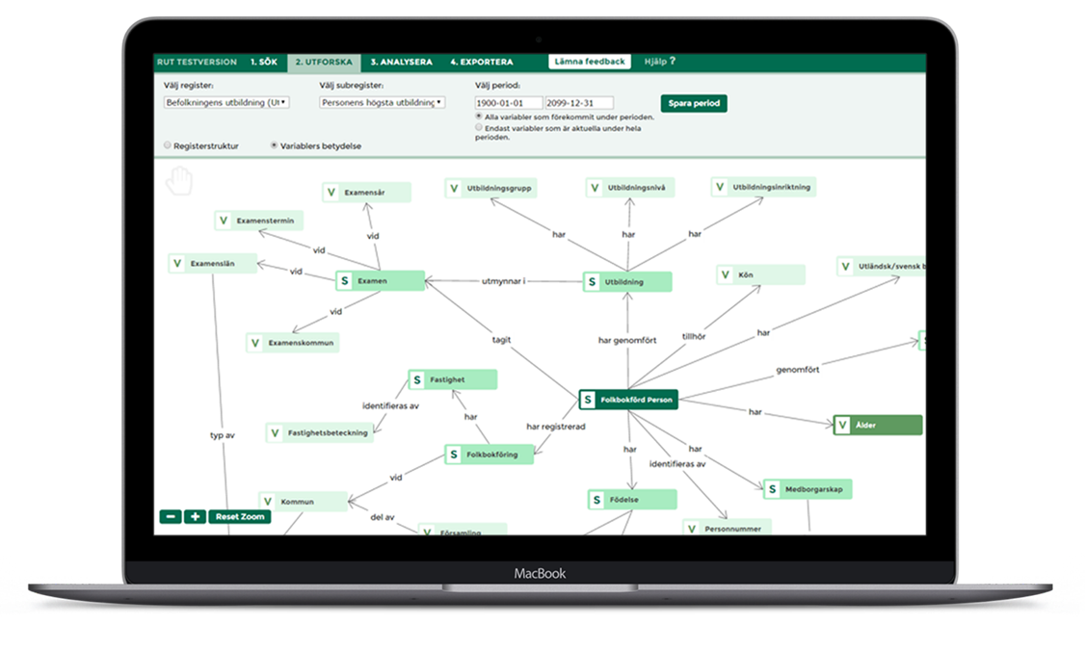
Register Utiliser Tool (RUT)
A tool to explore registers and biobanks on metadata level
Contains metadata on variables, populations, concepts, codelists, history from Swedish registers
Enables search, evaluation and comparison of metadata between different registers
Registers include: administrative registers, sample collections from biobanks, clinical registers, research databases
RUT aims to support FAIR data management
Read more at registerforskning.se

Slide 11
Data Management Plans

Slide 12
A working group on data management plans
Formas (Swedish Research Council for Environment, Agricultural Sciences and Spatial Planning)
Halmstad University
Karolinska Institutet
KTH Royal Institute of Technology
National Archives
Riksbankens Jubileumsfond (RJ)
Scilifelab
SND (Swedish National Data Service)
University of Gothenburg
SNIC (Swedish National Infrastructure for Computing)
SUHF (The Association of Swedish Higher Education Institutions)
Stockholm University
SLU (Swedish University of Agricultural Sciences)
Umeå University Library
Young Academy of Sweden
In order to support increased open access to research data the Swedish Research Council is coordinating the national work on data management plans, and has appointed a working group.
The group has representatives from following organisations:

Slide 13
A data management plan – central parts
As a first step, the Swedish Research Council has collaborated with the Association of Swedish Higher Education Institutions, SUHF, to produce a partially reworked version of Science Europe’s “Core Requirements for Data Management Plans”.
It consists of six central parts that a data management plan should include, with associated questions. The six central parts and associated questions can provide support when you produce a data management plan.

Slide 14
1. Description of data – reuse of existing data and/or production of new data
How will data be collected, created or reused?
What types of data will be created and/or collected, in terms of data format and amount/volume of data?
2. Documentation and data quality
How will the material be documented and described, with associated metadata relating to structure, standards and format for descriptions of the content, collection method, etc.?
How will data quality be safeguarded and documented (for example repeated measurements, validation of data input, etc.)?
3. Storage and backup
How is storage and backup of data and metadata safeguarded during the research process?
How is data security and controlled access to data safeguarded, in relation to the handling of sensitive data and personal data, for example?
4. Legal and ethical aspects
How is data handling according to legal requirements safeguarded, e.g. in terms of handling of personal data, confidentiality and intellectual property rights?
How is correct data handling according to ethical aspects safeguarded?
5. Accessibility and long-term storage
How, when and where will research data or information about data (metadata) be made accessible? Are there any conditions, embargoes and limitations on the access to and reuse of data to be considered?
In what way is long-term storage safeguarded, and by whom? How will the selection of data for long-term storage be made?
Will specific systems, software, source code or other types of services be necessary in order to understand, partake of or use/analyse data in the long term?
How will the use of unique and persistent identifiers, such as a Digital Object Identifier (DOI), be safeguarded?
6. Responsibility and resources
Who is responsible for data management and (possibly) supports the work with this while the research project is in progress? Who is responsible for data management, ongoing management and long-term storage after the research project has ended?
What resources (costs, labour input or other) will be required for data management (including storage, back-up, provision of access and processing for long-term storage)? What resources will be needed to ensure that data fulfil the FAIR principles?

Slide 15
A tool for data management plans
There are different needs on DMPs based on different processes and stakeholders (including coordination functions): - researcher - infrastructures - data service providers - higher education institutions - financiers - domain-specific and local perspectives, archiving and preservation, etc.
. Connection between DMS and FAIR.
The working group will look at needs for basic requirements on functionality.

Slide 16
Thank you for your attention! sanja.halling@vr.se openscience@vr.se
If it is not stated otherwise, photos in the presentation are from depositphotos.com.

