Slide 1
FAIRness in practise:
How to achieve it?
Benjamin Pfeil
Bjerknes Climate Data Centre &
RI ICOS Ocean Thematic Centre
Geophysical Institute/University of Bergen, Norway
Notes:
Data som kjernen I forsking

Slide 2
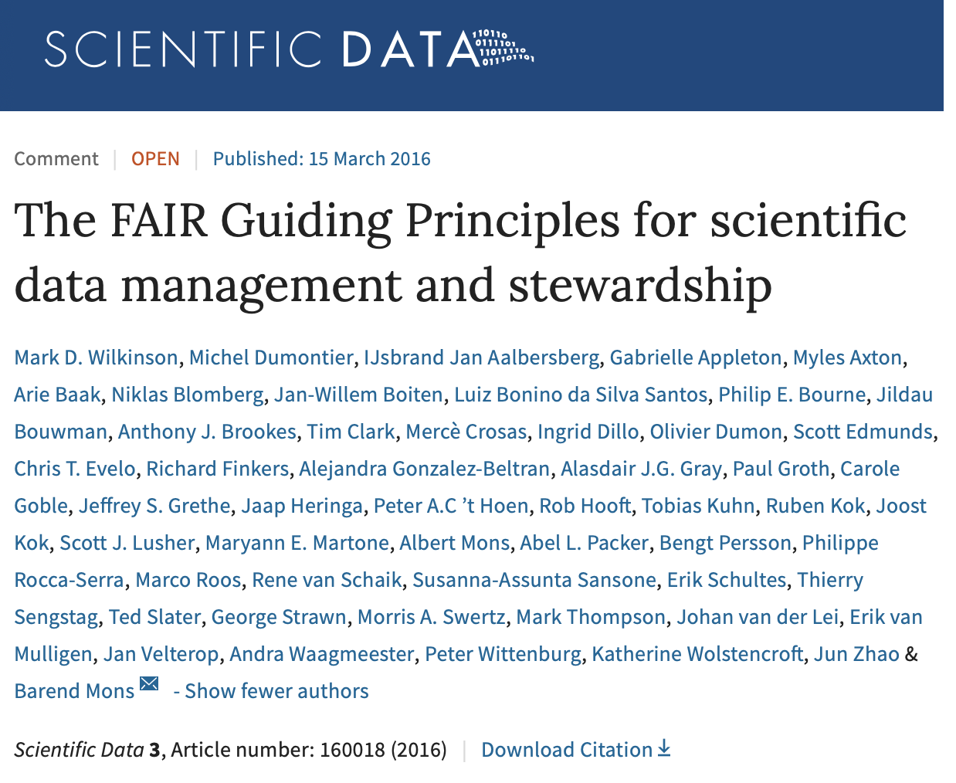
Urgent need to improve the infrastructure supporting the re-use of scholarly data
A diverse set of stakeholders designed and endorsed a concise and measureable set of principles – the FAIR Data Principles
Guideline for those wishing to enhance the reusability of their data
FAIR Principles put specific emphasis on enhancing the ability of machines to automatically find and use the data (in addition to supporting its reuse by individual)
Notes:
‘Good data management’ is not a goal in itself, but rather is the key conduit leading to knowledge discovery and innovation, and to subsequent data and knowledge integration and reuse by the community after the data publication process
Unfortunately, the existing digital ecosystem surrounding scholarly data publication prevents us from extracting maximum benefit from our research investments
Partially in response to this, science funders, publishers and governmental agencies are beginning to require data management and stewardship plans for data generated in publicly funded experiments
Beyond proper collection, annotation, and archival, data stewardship includes the notion of ‘long-term care’ of valuable digital assets, with the goal that they should be discovered and re-used for downstream investigations, either alone, or in combination with newly generated data
The outcomes from good data management and stewardship, therefore, are high quality digital publications that facilitate and simplify this ongoing process of discovery, evaluation, and reuse in downstream studies
What constitutes ‘good data management’ is, however, largely undefined, and is generally left as a decision for the data or repository owner. Therefore, bringing some clarity around the goals and desiderata of good data management and stewardship, and defining simple guideposts to inform those who publish and/or preserve scholarly data, would be of great utility.

Slide 3
The FAIR Guiding Principles
To be Findable:
F1. (meta)data are assigned a globally unique and persistent identifier
F2. data are described with rich metadata (defined by R1 below)
F3. metadata clearly and explicitly include the identifier of the data it describes
F4. (meta)data are registered or indexed in a searchable resource
To be Accessible:
A1. (meta)data are retrievable by their identifier using a standardized communications protocol
A1.1 the protocol is open, free, and universally implementable
A1.2 the protocol allows for an authentication and authorization procedure, where necessary
A2. metadata are accessible, even when the data are no longer available
To be Interoperable:
I1. (meta)data use a formal, accessible, shared, and broadly applicable language for knowledge representation.
I2. (meta)data use vocabularies that follow FAIR principles
I3. (meta)data include qualified references to other (meta)data
To be Reusable:
R1. meta(data) are richly described with a plurality of accurate and relevant attributes
R1.1. (meta)data are released with a clear and accessible data usage license
R1.2. (meta)data are associated with detailed provenance
R1.3. (meta)data meet domain-relevant community standards

Slide 4
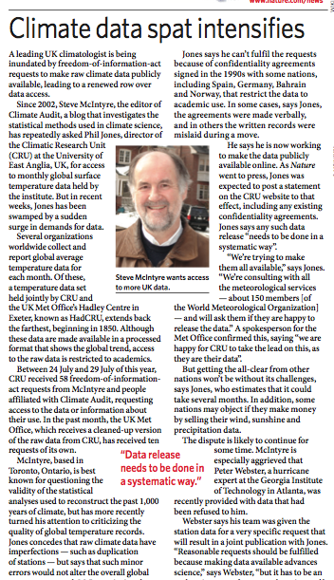
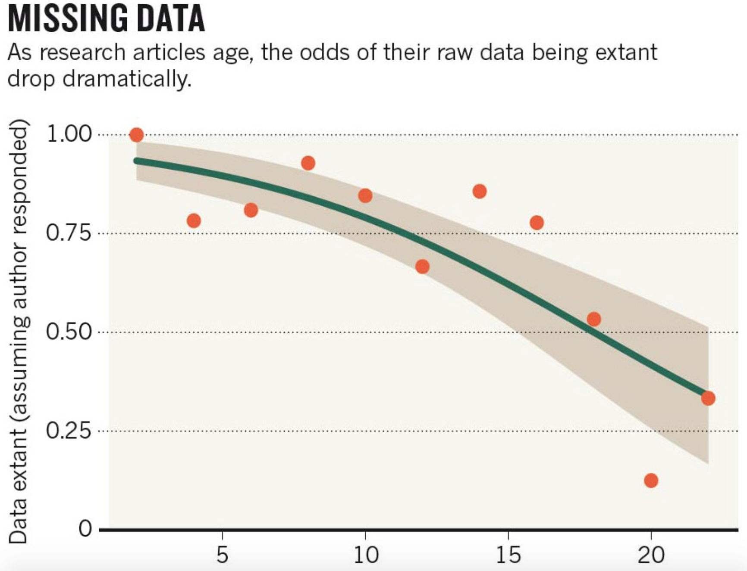
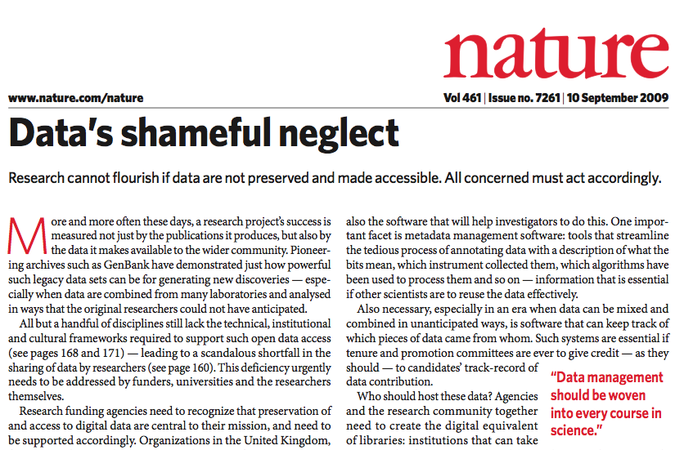
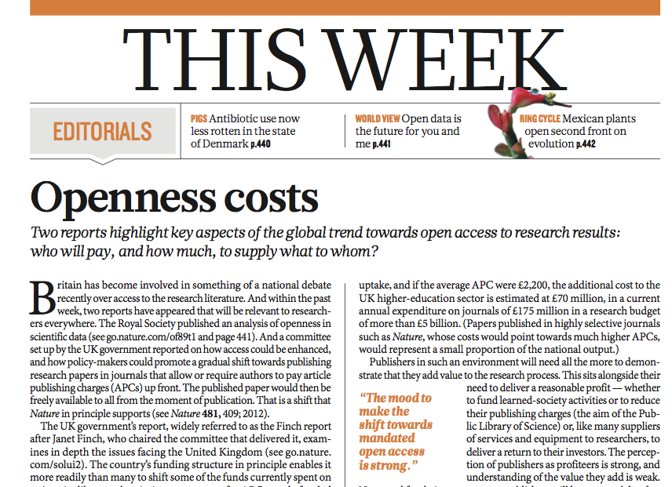
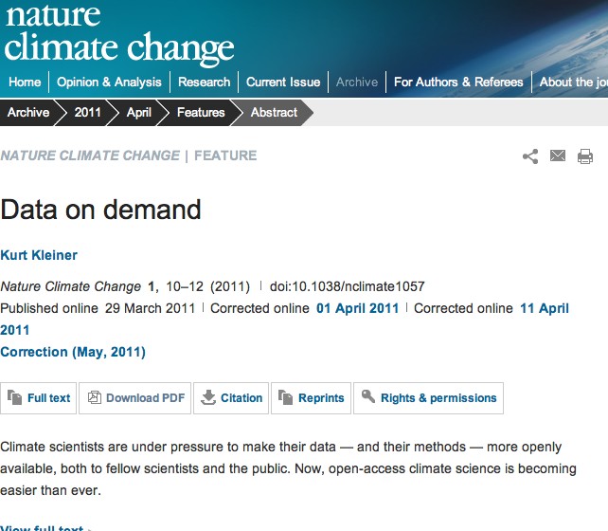
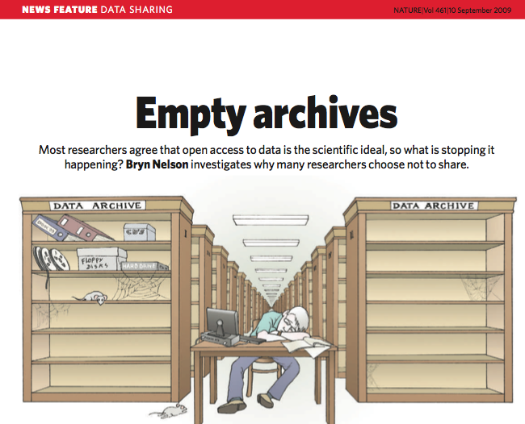
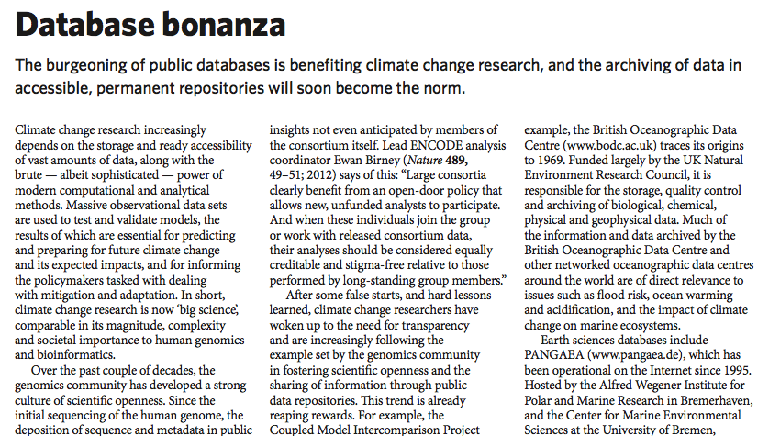
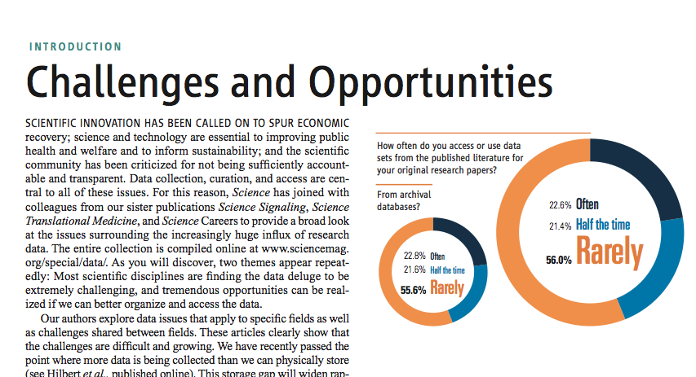
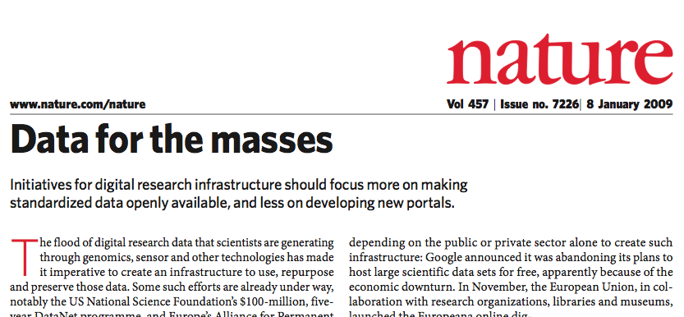

Slide 5
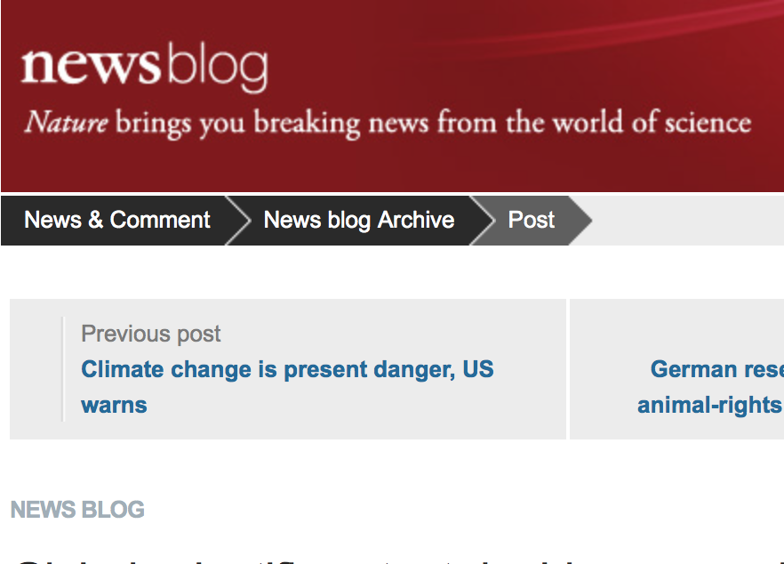
Global increase in publications in empirical sciences

Slide 6
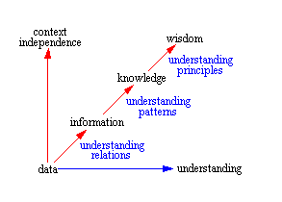
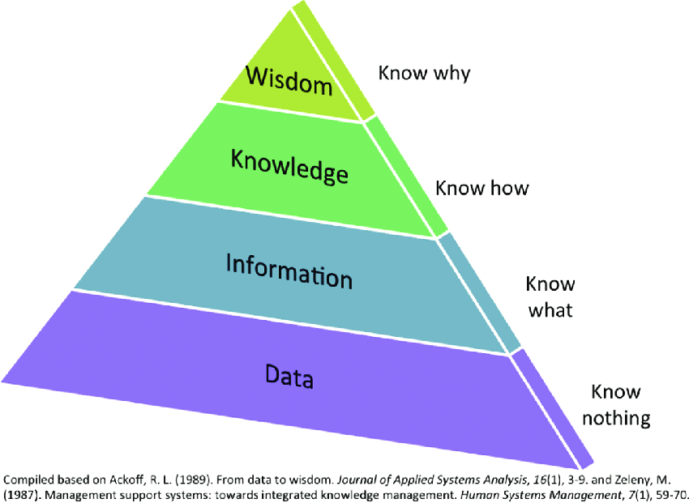
DIKW
‘Good data management is not a goal in itself, but rather is the key conduit leading to knowledge discovery and innovation’ Wilkinson et al., Sci. Data, 2016

Slide 7
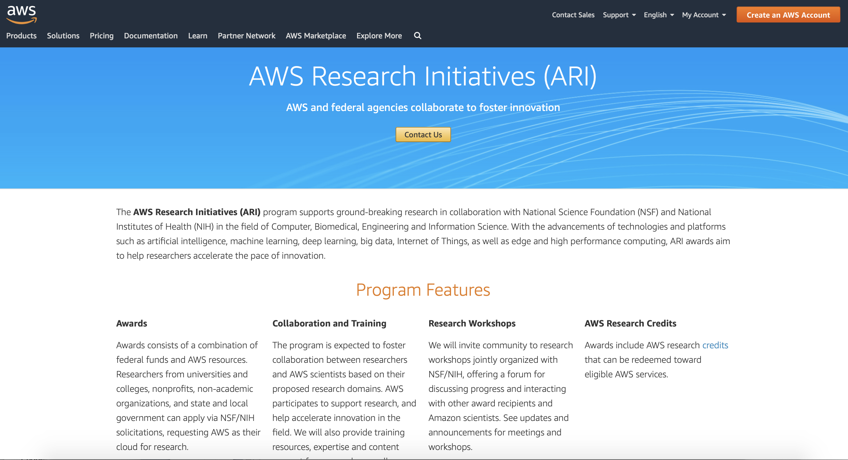

Slide 8
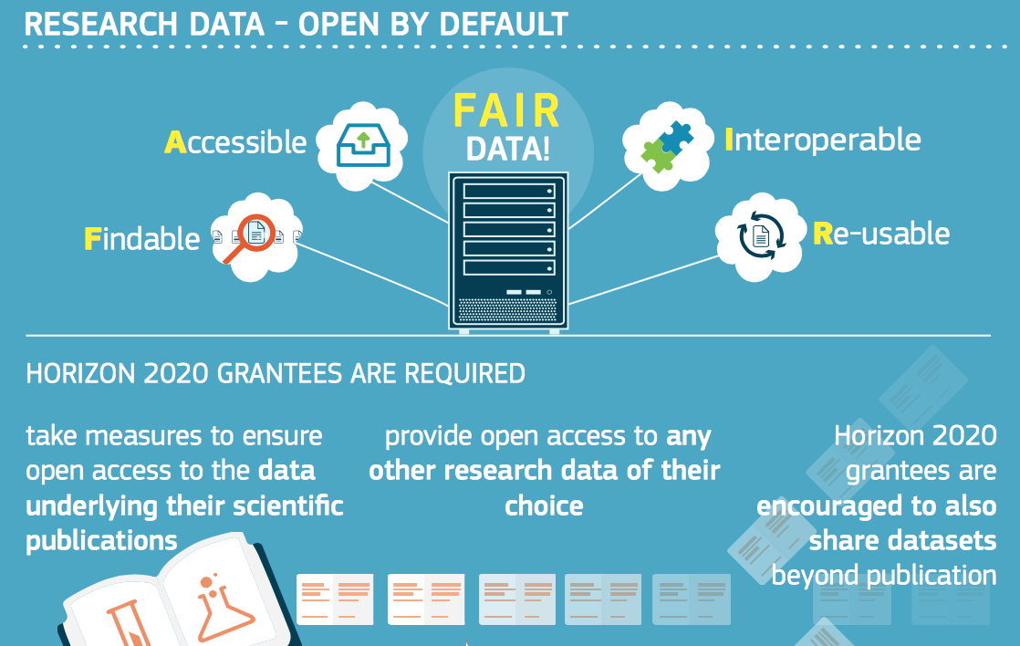
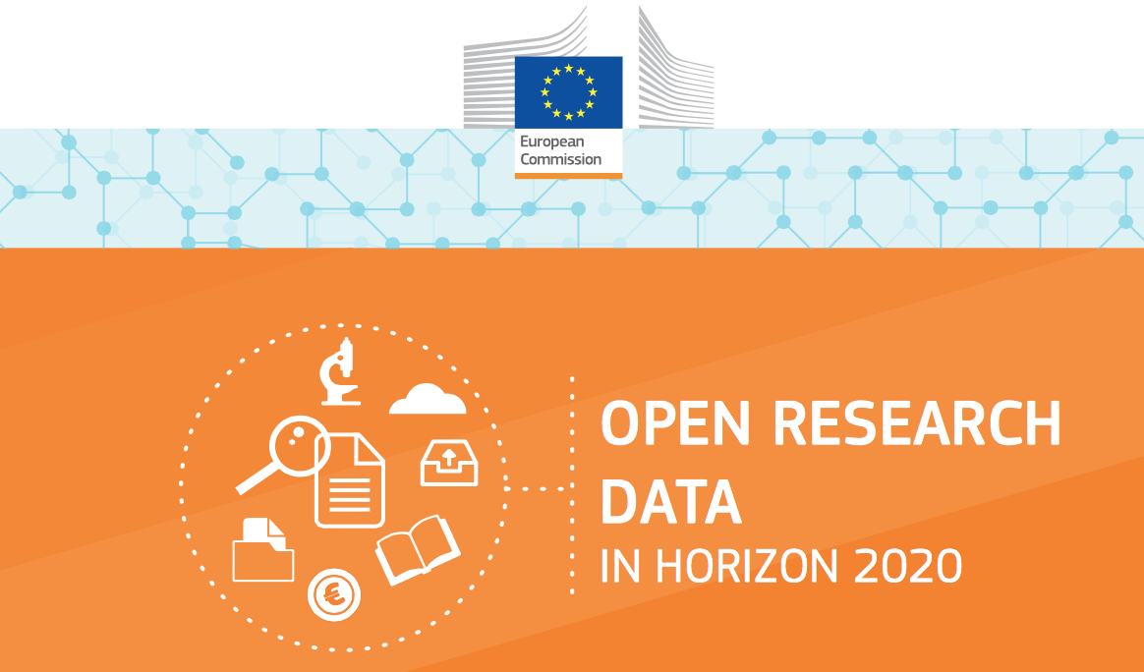
Data management is mandatory for all EU and (most) national funded projects
Notes:
Services connect the technical infrastructure with the user

Slide 9
FAIR Guiding Principles
have rapidly been adopted by publishers, funders, and pan-disciplinary infrastructure programmes and societies
present guidelines for the publication of digital resources
are aspirational, in that they do not strictly define how to achieve a state of “FAIRness”
describe a continuum of features, attributes, and behaviors that will move a digital resource closer to that goal
this led to a wide range of interpretations of FAIRness
a number of incompatible methodologies to assess FAIRness have been developed already
Source: Wilkinson, M. D. et al. A design framework and exemplar metrics for FAIRness. Sci. Data 5:180118 doi: 10.1038/sdata.2018.118 (2018).
FAIR Data Maturity Model
WG Case Statement

Slide 10
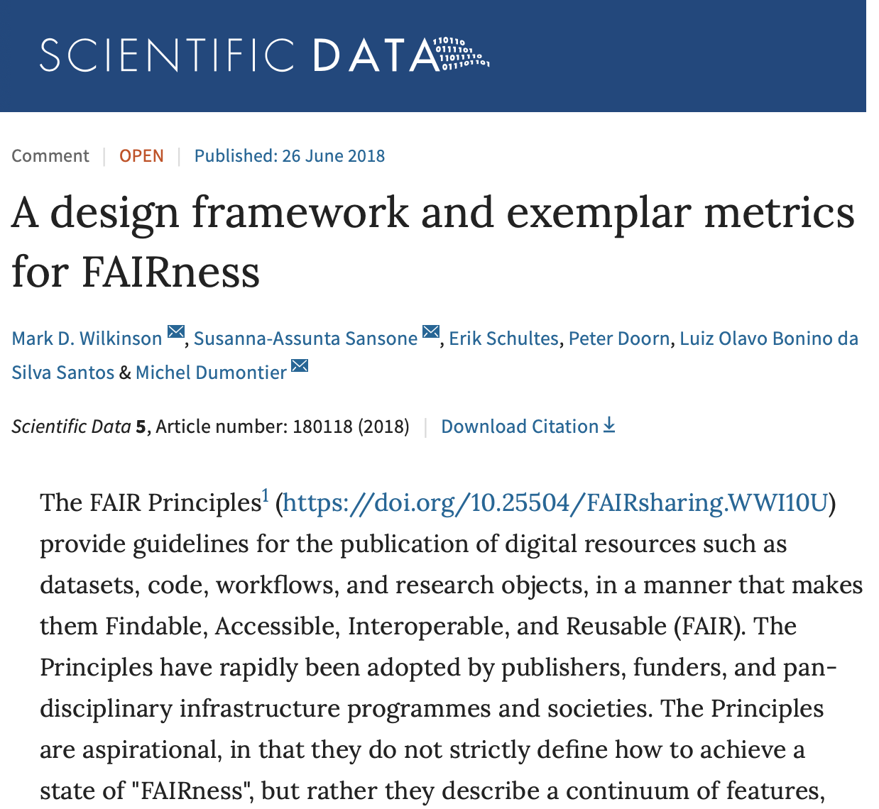
‘It would focus on FAIRness for machines – i.e., the degree to which a digital resource is findable, accessible, interoperable, and re-usable without human intervention’
This was because FAIRness for people would be difficult to measure objectively, as it would often depend on the experience and prior-knowledge of the individual attempting to find and access the data.

Slide 11
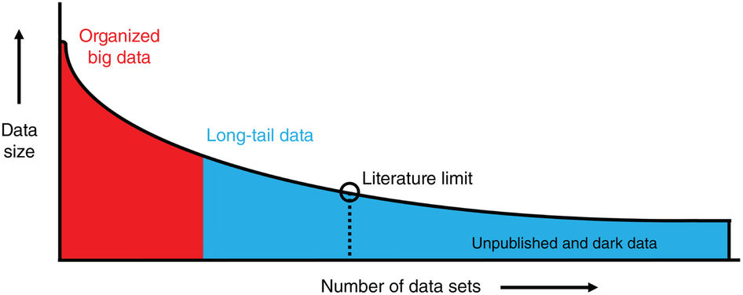
Classification of scientific data
Operational data flow e.g.
Research Infrastructures,
model output, remote sensing
(Ferguson et al., 2014, Nature)

Slide 12
Environmental Research Infrastructures building FAIR services accessible for society, innovation and research
Coordination: Andreas Petzold a.petzold@fz-juelich.de
Ari Asmi ari.asmi@helsinki.fi

Slide 13
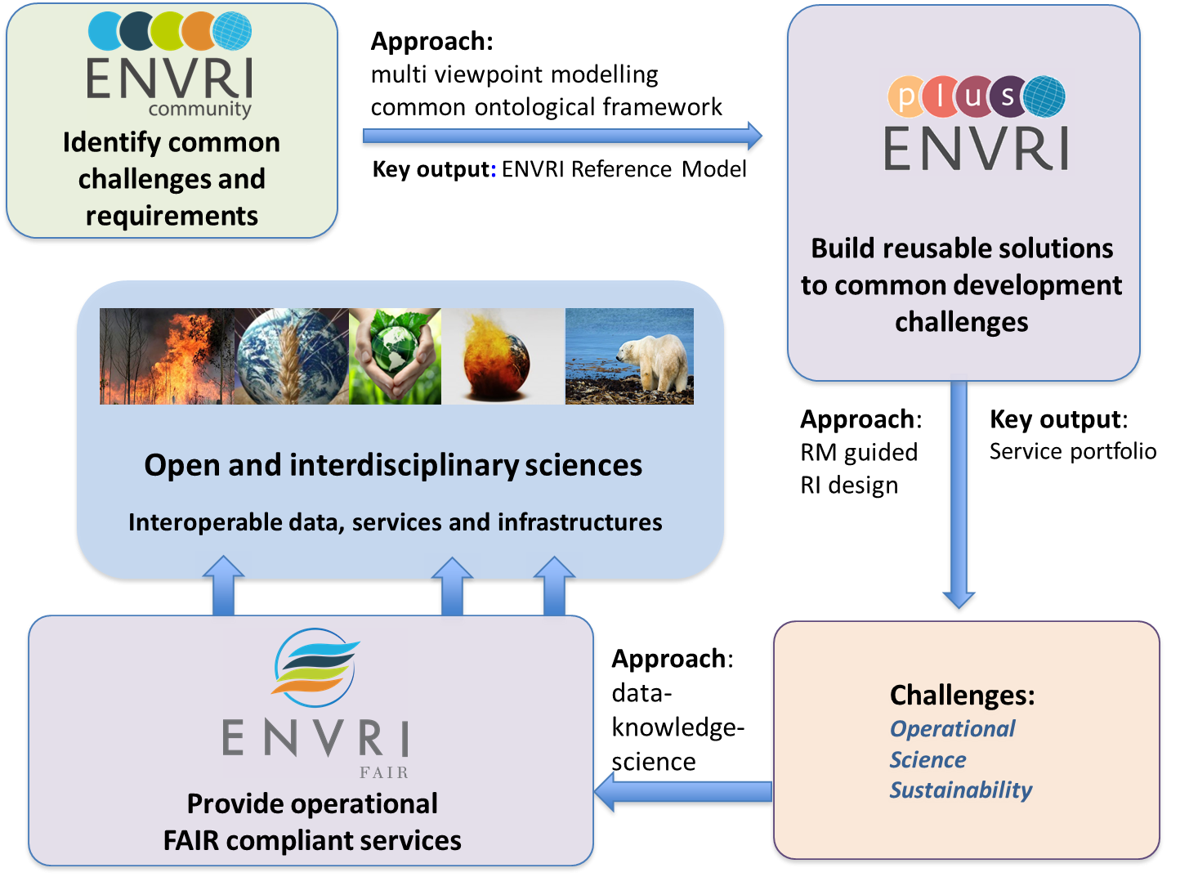
The Earth is our Lab
Europe’s Environmental Research Infrastructures
ENVRI
Community Building
Common framework
ENVRI Reference Model
ENVRIplus
Common developments
Shared solutions for RI
Service portfolio
ENVRI-FAIR
Enabling RI for FAIR
FAIR compliant services
Link ENVRI to EOSC

Slide 14
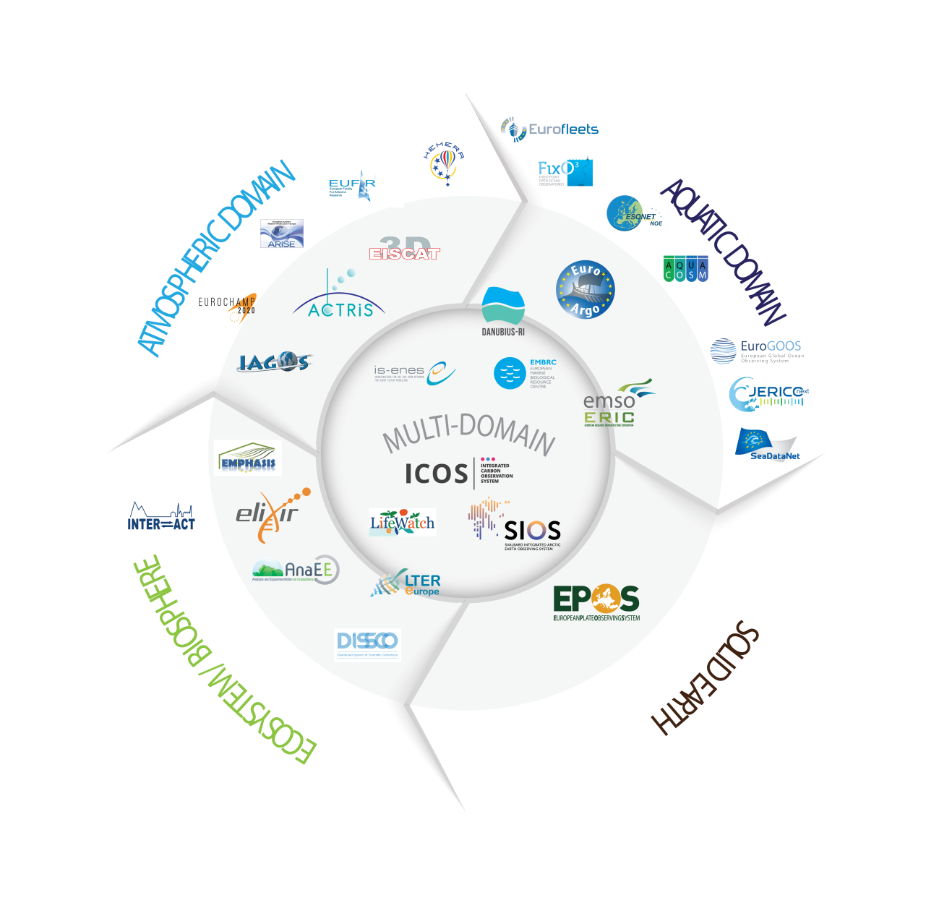
The Earth is our Lab
Europe’s Environmental Research Infrastructures
ENVRI
Community Building
Common framework
ENVRI Reference Model
ENVRIplus
Common developments
Shared solutions for RI
Service portfolio
ENVRI-FAIR
Enabling RI for FAIR
FAIR compliant services
Link ENVRI to EOSC
13 ENV RIs | 37 partners | launch 01 January 2019 | envri-fair.eu

Slide 15
The Earth is our Lab
Europe’s Environmental Research Infrastructures
ENVRI-FAIR mission
Share experiences and find common solutions to
data sharing,
accessibility,
interoperability
Develop joint services
Expose services to EOSC
Prepare ENVRI-hub
13 ENV RIs | 37 partners | launch 01 January 2019 | envri-fair.eu

Slide 16
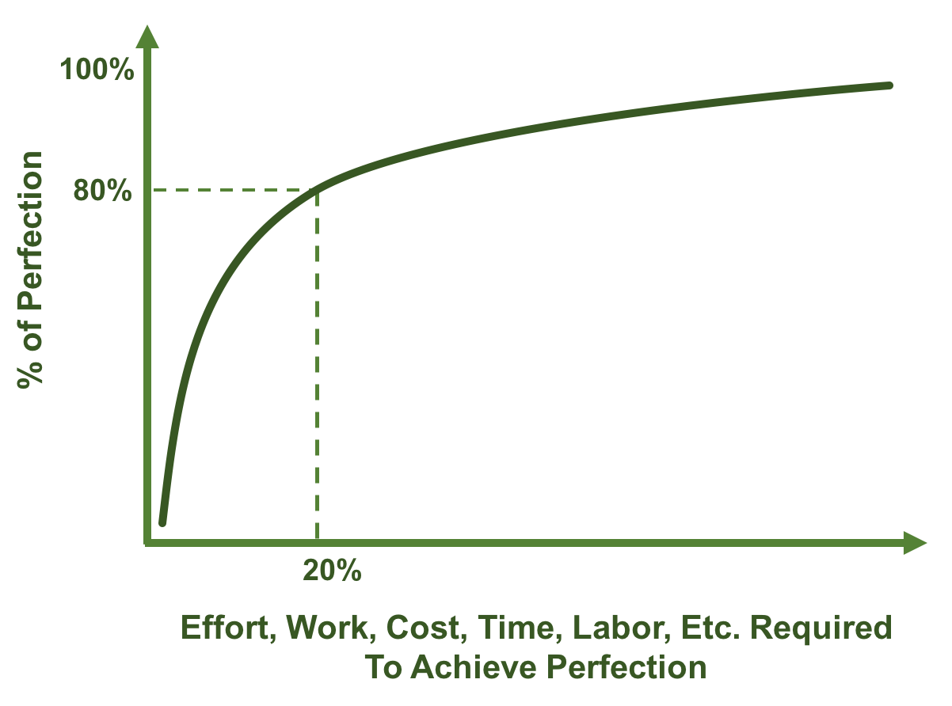
Challenge of handling scientific data:
Ferguson et al., Nature, 2014
operational
Pareto Principle 80/20 rule

Slide 17
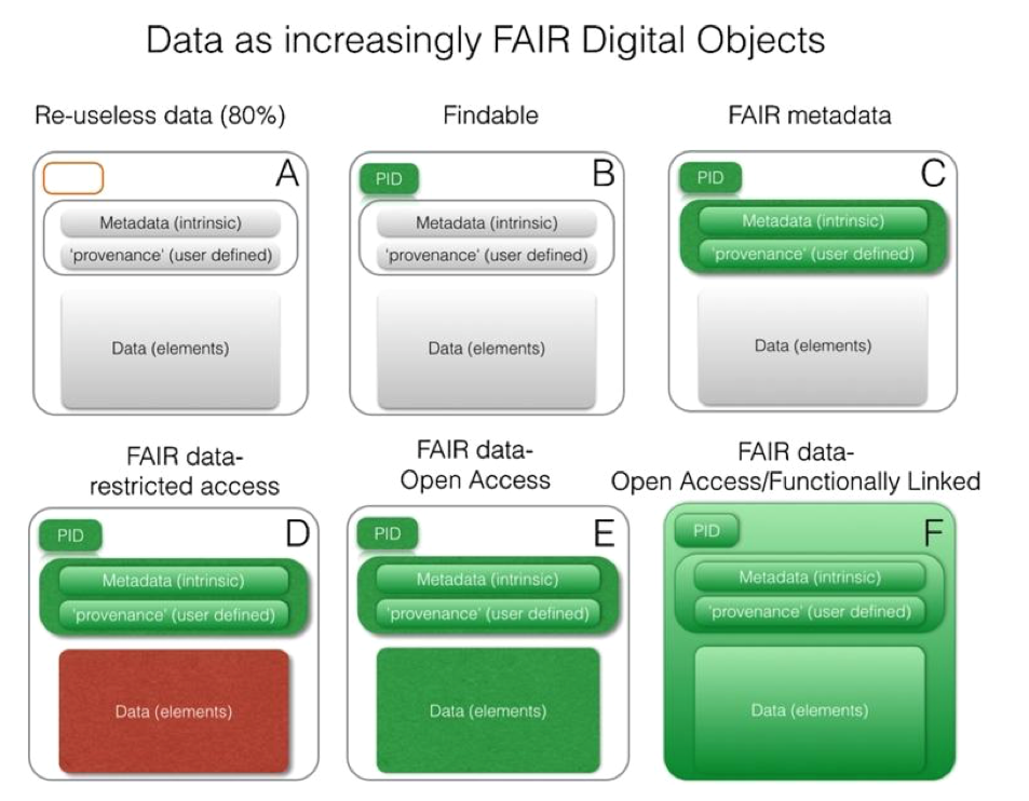
Publication level
Needed level for nearly
all data in the field of natural sciences

Slide 18
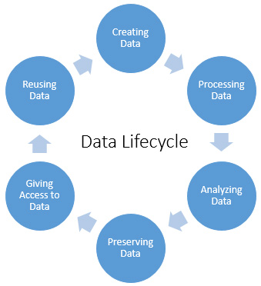
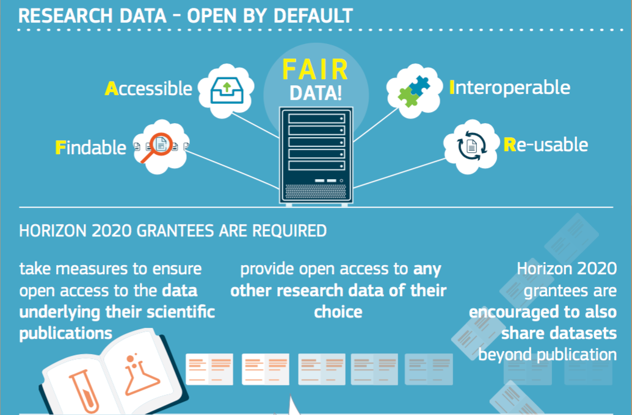
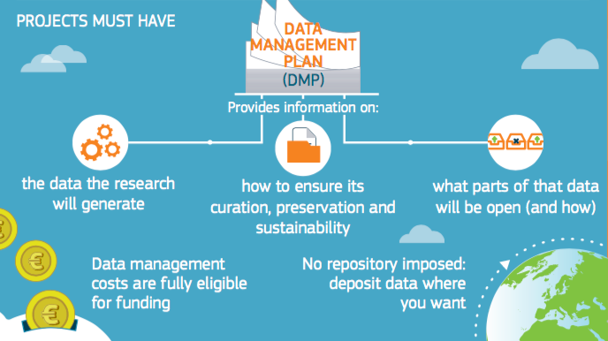
Managing research data according to FAIR principle
Estimated cost: 5% of the received funding (eligible cost)!
Notes:
Pluss 16 faste jobber ved Norsk Marin Datasenter /IMR!

Slide 19
The FAIR Guiding Principles
FAIRness in practise:
How to achieve it?
To be Findable:
F1. (meta)data are assigned a globally unique and persistent identifier
F2. data are described with rich metadata (defined by R1 below)
F3. metadata clearly and explicitly include the identifier of the data it describes
F4. (meta)data are registered or indexed in a searchable resource
To be Accessible:
A1. (meta)data are retrievable by their identifier using a standardized communications protocol
A1.1 the protocol is open, free, and universally implementable
A1.2 the protocol allows for an authentication and authorization procedure, where necessary
A2. metadata are accessible, even when the data are no longer available
To be Interoperable:
I1. (meta)data use a formal, accessible, shared, and broadly applicable language for knowledge representation.
I2. (meta)data use vocabularies that follow FAIR principles
I3. (meta)data include qualified references to other (meta)data
To be Reusable:
R1. meta(data) are richly described with a plurality of accurate and relevant attributes
R1.1. (meta)data are released with a clear and accessible data usage license
R1.2. (meta)data are associated with detailed provenance
R1.3. (meta)data meet domain-relevant community standards
Solely funding either the scientists or long-term repositories infrastructure part will not make data FAIR
Close communication with the scientists to understand their needs (and fears) and establishing domain specific metrics that can be implemented
Scientists need an infrastructure that supports them and takes care of the technical details
Need for professional (scientific) data managers working in close collaboration with the scientific community and long-term repositories

Slide 20
The FAIR Guiding Principles - responsibilities
To be Findable:
F1. (meta)data are assigned a globally unique and persistent identifier
F2. data are described with rich metadata (defined by R1 below)
F3. metadata clearly and explicitly include the identifier of the data it describes
F4. (meta)data are registered or indexed in a searchable resource
To be Accessible:
A1. (meta)data are retrievable by their identifier using a standardized communications protocol
A1.1 the protocol is open, free, and universally implementable
A1.2 the protocol allows for an authentication and authorization procedure, where necessary
A2. metadata are accessible, even when the data are no longer available
To be Interoperable:
I1. (meta)data use a formal, accessible, shared, and broadly applicable language for knowledge representation.
I2. (meta)data use vocabularies that follow FAIR principles
I3. (meta)data include qualified references to other (meta)data
To be Reusable:
R1. meta(data) are richly described with a plurality of accurate and relevant attributes
R1.1. (meta)data are released with a clear and accessible data usage license
R1.2. (meta)data are associated with detailed provenance
R1.3. (meta)data meet domain-relevant community standards
Erik Schulte refers to it
We have to ensure that science is not detached from technology and that scientists trust the services possible through FAIRness!
Red: scientific community
Blue: long-term archive

Slide 21
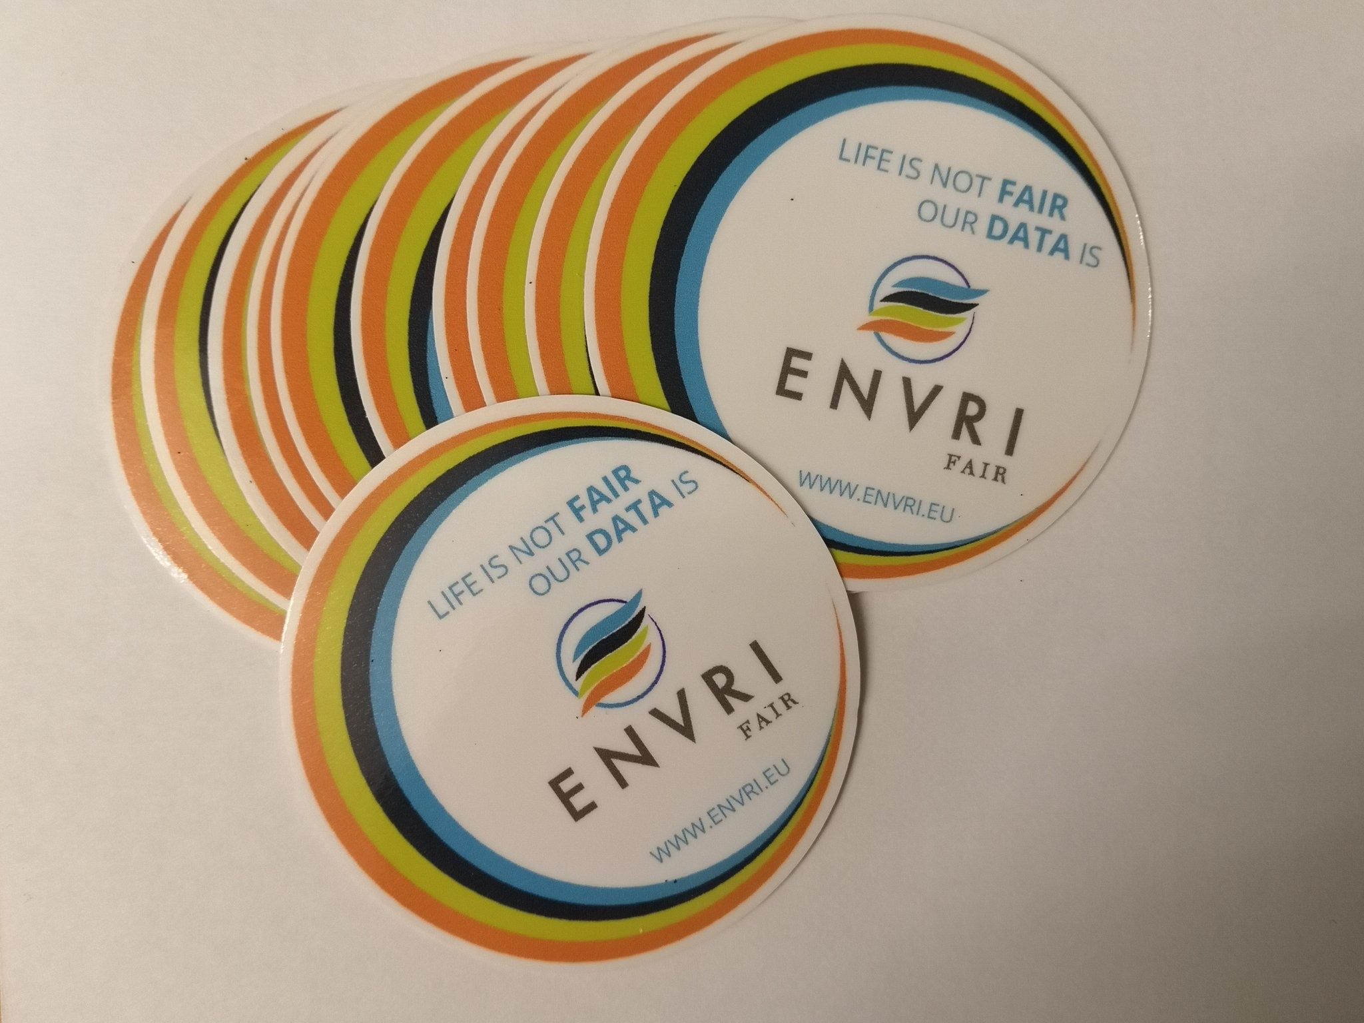
‘The value of data lies in their use.’
Bits of Power, Issues on Global Access to Scientific Data, US National Research Council 1997
Thank you!

