Slide 1
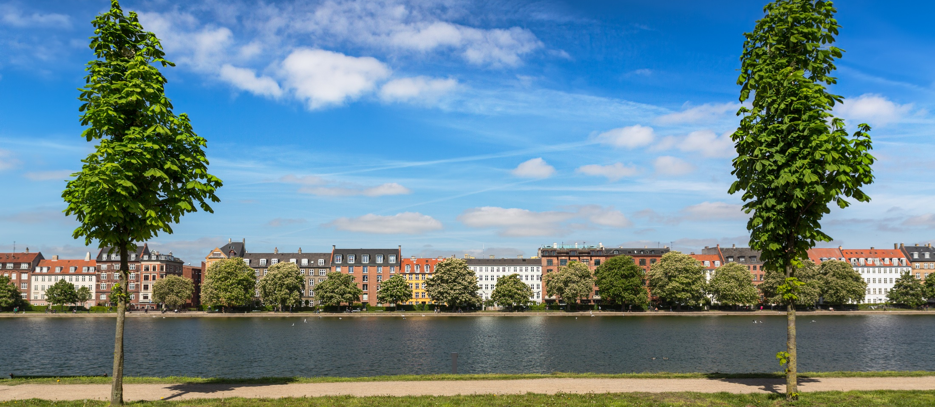
The Danish ambitions towards future
Research Infrastructure Collaboration
John Renner Hansen,
Chairman of DeiC Board
NeiC Conference 2019 - 14. May 2019

Slide 2

Riding the wave
How Europe can gain from the rising tide of scientific data a vision for 2030
Final Report of the High Level Expert
Group on Scientific Data to be launched 6 Oct 2010
John Wood

Slide 3

Vision 2030 high-level experts group on Scientific Data
“Our vision is a scientific e-Infrastructure that supports seamless access, use, re-use and trust of data. In a sense, the physical and technical infrastructure becomes invisible and the data themselves become the infrastructure – a valuable asset, on which science, technology, the economy and society can advance.”
  High-Level Group on Scientific Data
  “Riding the Wave: how Europe can gain from the raising tide of scientific data”

Slide 4

Restructuring for the Future
Increasing amounts of data across the scientific fields, including new fields
Doubles every 6-12 month, requires access to increasingly larger computer structures – exascale
Political pressure to comply with Open Science standards
Whish to participate in European initiatives:
European Open Science Cloud, Fair Data, EuroHPC…
Mandate of existing DeiC expired
Time to take a step back and consider
  Organization of the national digital research infrastructure
  Ownership and collaboration across Danish universities
  Funding
  Involvement in international activities and projects

Slide 5

Vision
Researchers and students at the 8 Danish Universities have access to a digital infrastructure enabling world-class research and education
Access is seamless and the infra-
structure is delivered ”as-a-service”
Including professional help at all levels of IT user competences

Slide 6









The Stake Holder Map

Slide 7
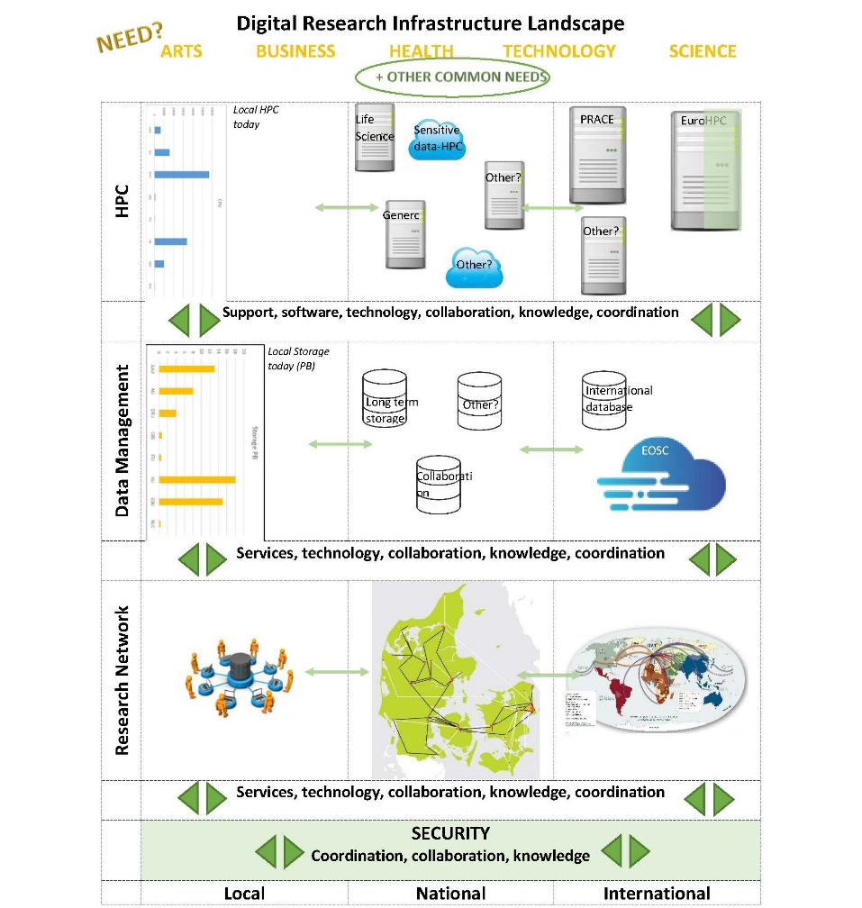

Slide 8
To fulfill the Vision more funding is needed
We expect a significant increase in the annual
investment in the e-Infrastructure for
research and research based education,
installed through a common plan agreed
between the universities and the
Ministry of Higher Education and Reseach

Slide 9

2019 – the Year of Preparation
New interim board with representatives from all 8 universities (owners), members selected from the university top management level
Agreement between the universities and the ministry on future funding (50:50) with recommendation from the Board and the eight universities
Definition of the future HPC landscape:
local/national/international
Definition of the future storage and
data management landscape
Establishment of an organization,
that supports the national and
international collaboration

Slide 10
Future HPC landscape
Denmark national member of EuroHPC Joint Undertaking
Denmark participates in the CSC lead EU application for hosting a pre-exascale computer ”LUMI”
Continued membership of PRACE in 2020
Working group to specify needs and requirements for 3-4 national computers to be established in the coming years
Including support and competence building

Slide 11
Future storage and data management
Supporting FAIR and open data
Participating in EOSC and EOSC Nordic
Initiatives to involve the universities even more – Roadshow to engage the researchers
Working group to specify needs and requirements for national storage initiatives and supporting data management systems and activities

Slide 12

International collaboration
A strong national representation in important international digital research infrastructures
Ensuring knowledge transfer
And the best possibilities for the Danish researchers
We look forward to continue the
collaboration with our Nordic and
international partners

