Slide 1

Research perspectives on Artificial Intelligence, transparency, privacy & law
Anders Løland
assistant research director co-director
NeIC 2019

Slide 2

amazon.com
$106.23

Slide 3
Seller 1 =
0.9983 x Seller 2
Seller 2 =
1.270589 x Seller 1

Slide 4
amazon.com
$23,698,655.93
https://www.wired.com/2011/04/amazon-flies-24-million/

Slide 5
AI = a combination of myriads of such simple algorithms

Slide 6
why AI struggles in the real world
– five key challenges
#1 games
#2 data
#3 black boxes
#4 unfair models
#5 shortcuts

Slide 7
reason #1:
the real world is not a game

Slide 8
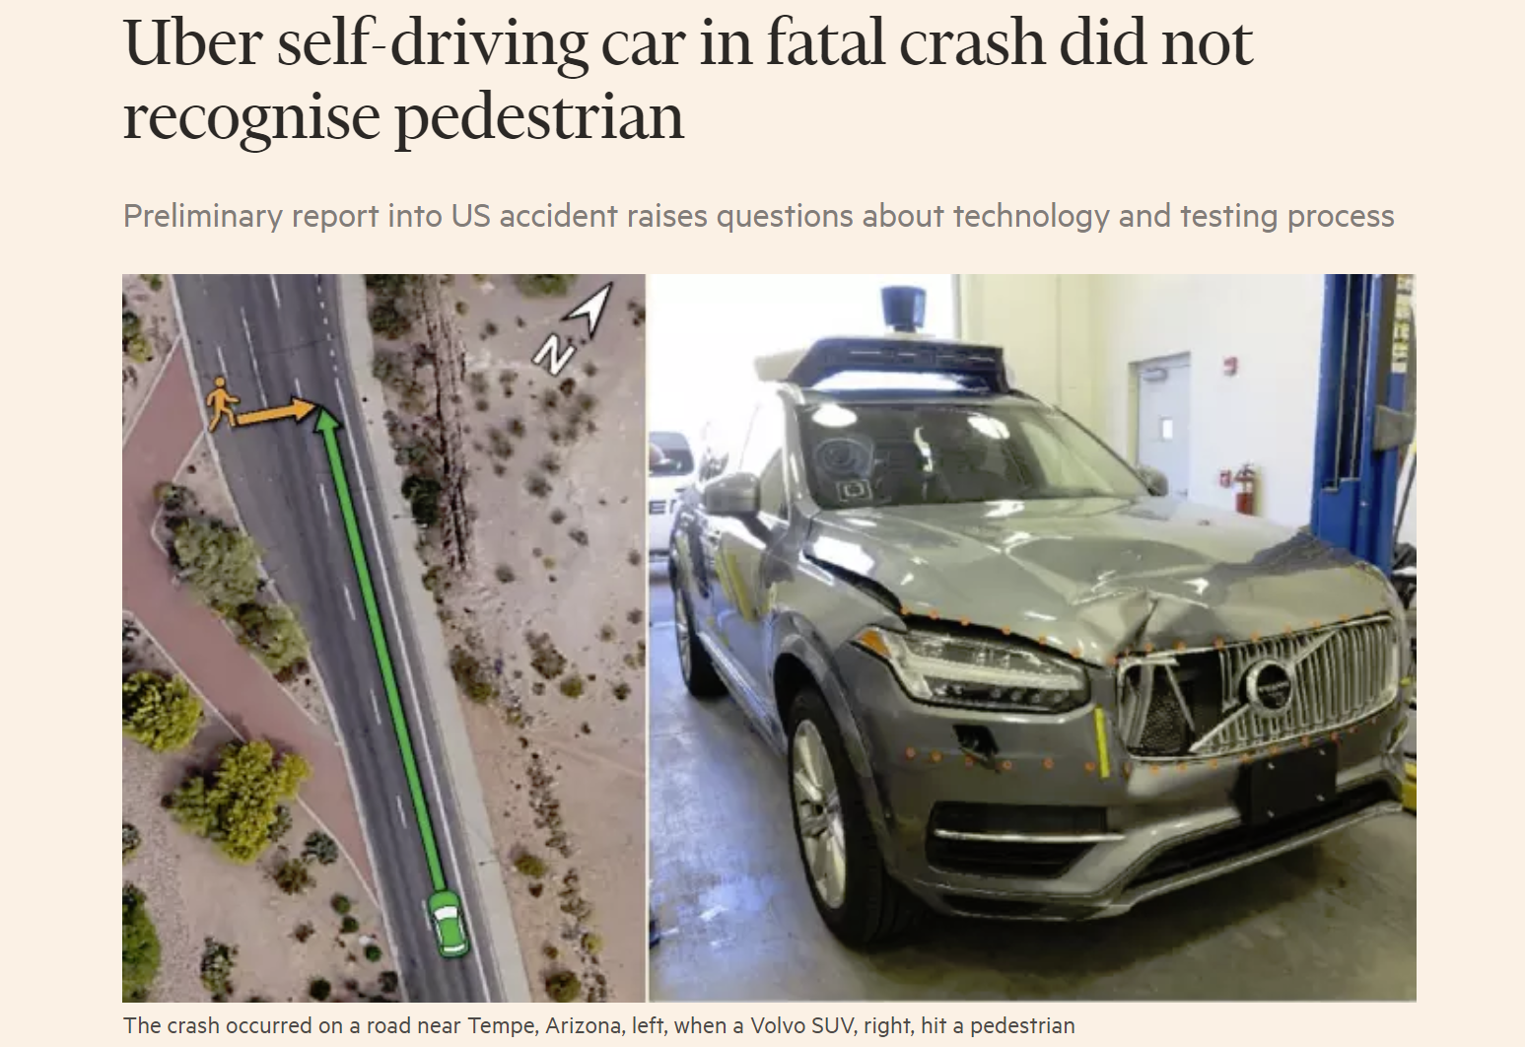
Financial Times, May 24 2018

Slide 9
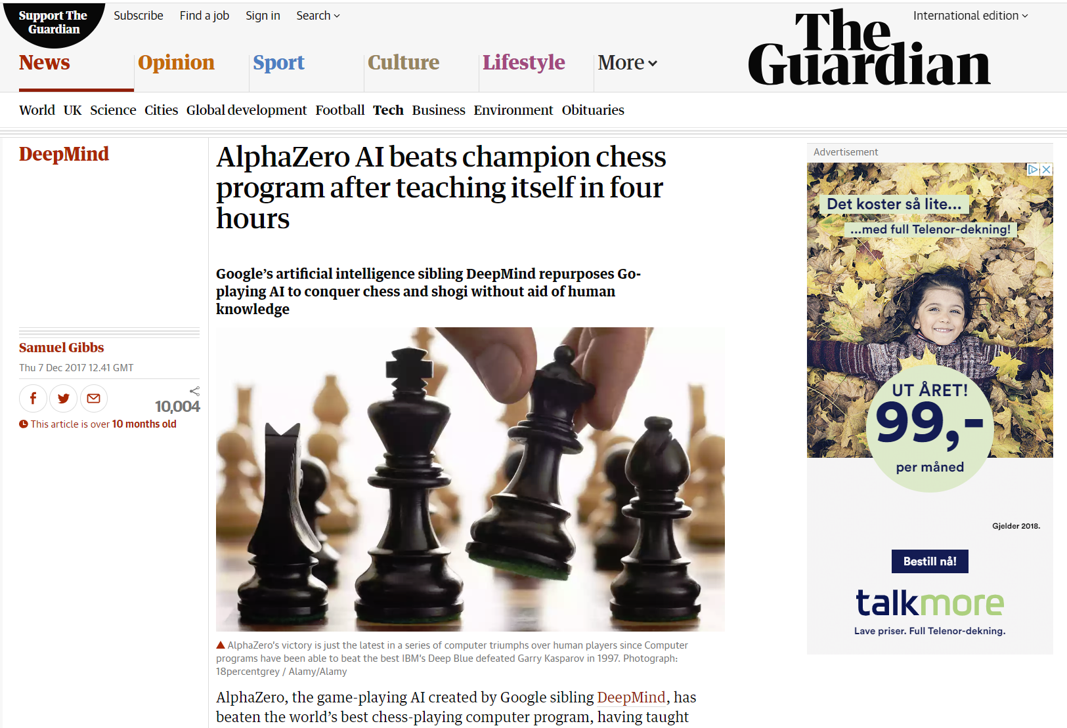

Slide 10
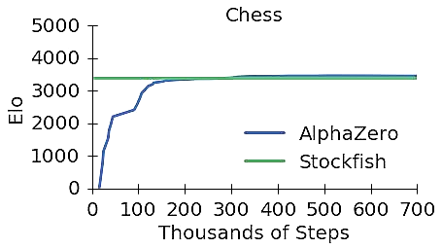

Silver, David, et al. "Mastering chess and shogi by self-play with a general reinforcement learning algorithm." arXiv preprint (2017).

Slide 11
4 hours
= 20 million training games

Slide 12
2 hours/game
= 1.7 million days of chess

Slide 13

Simple rules

Slide 14

Complicated rules

Slide 15
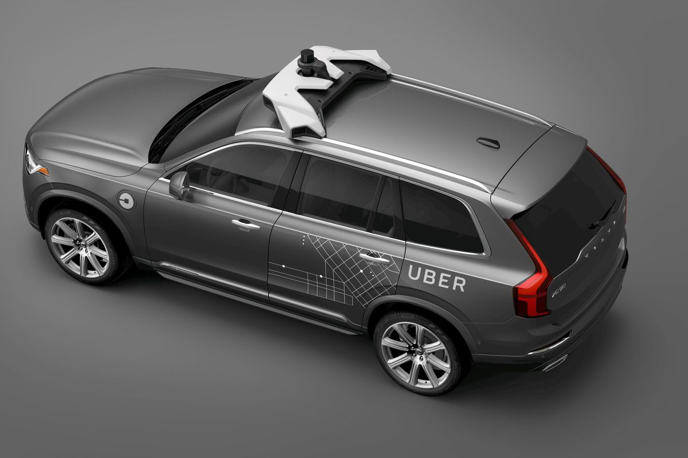

Slide 16
We would need
20 million drives
½ crash
½ successful

Slide 17
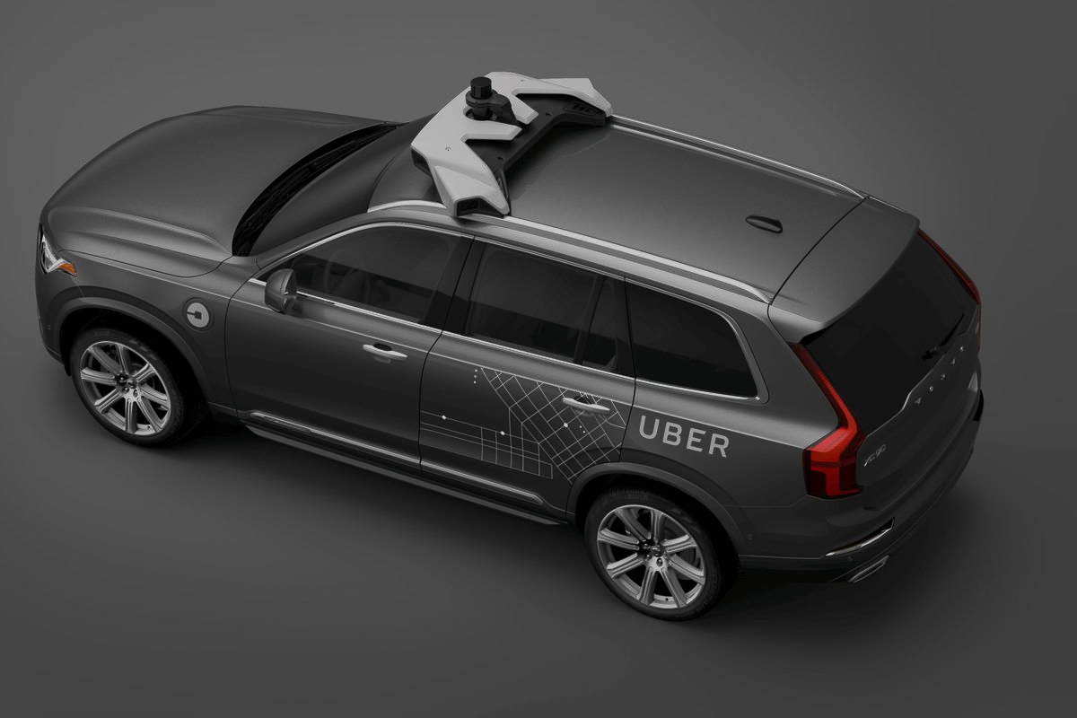
Simply not possible to simulate realistic drives

Slide 18


Slide 19

Photo: Bjørn Jarle Kvande

Slide 20
key challenge #1
AI must be
more robust

Slide 21
reason #2:
bad data

Slide 22
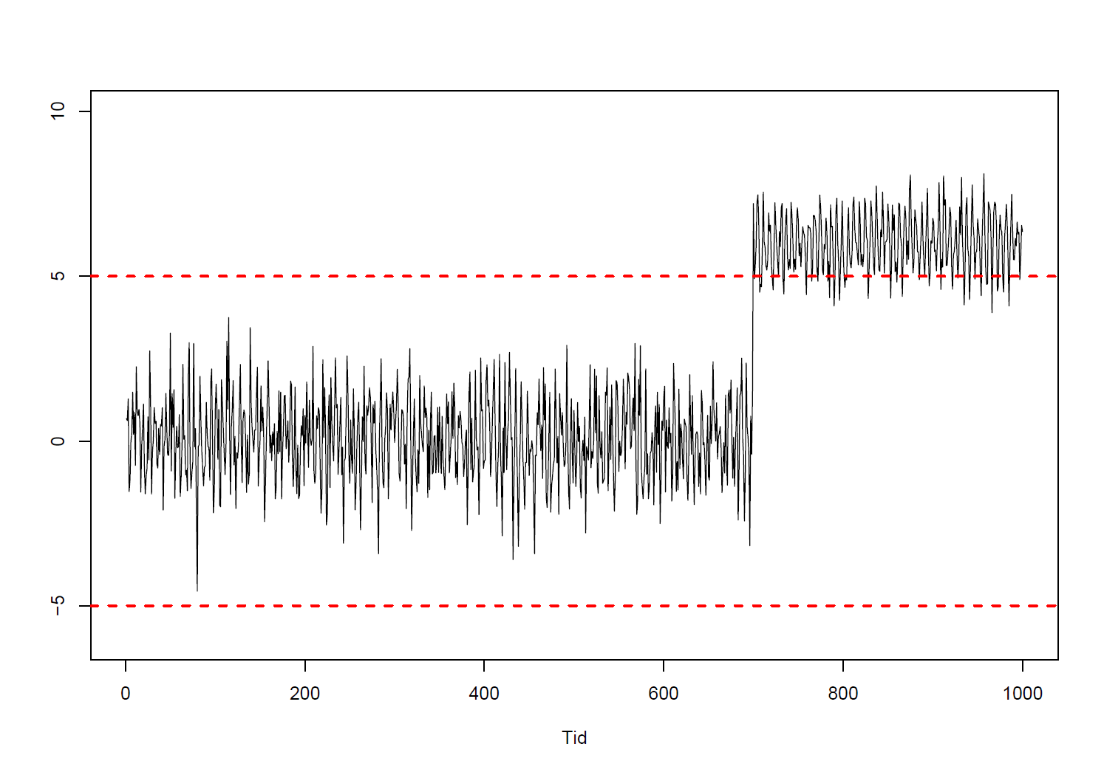
Simulated sensor data
Alarm

Slide 23
Alarm?
Errors must be
annotated
Missing data
Real world sensor data
Engine temperature (°C)
Measurement error?

Slide 24
a whole new field
is emerging:
data engineering

Slide 25
key challenge #2
how can we ensure quality data – and where can you study to be a data engineer?

Slide 26
reason #3:
artificial intelligence is a black box

Slide 27
“Big data is a step forward,” […] “But our problems are not lack of access to data, but understanding them. [Big data] is very useful if I want to find out something without going to the library, but I have to understand it, and that’s the problem.”
– Noam Chomsky in 2013
https://www.cnbc.com/2013/11/22/a-brief-history-of-big-data-the-noam-chomsky-way.html

Slide 28
AI: a probability of 30% that you will default on your loan

Slide 29
AI: loan application denied

Slide 30

you:

Slide 31
Zhang, Wu and Zhu (2018)
Interpretable CNNs
The IEEE Conference on Computer Vision and Pattern Recognition

Slide 32


Slide 33
major problem: dependent variables can/will cause havoc

Slide 34
what can happen
if AI gives you a
wrong explanation?

Slide 35


Slide 36
key challenge #3
open the
black box to everyone

Slide 37
reason #4:
artificial intelligence
is unfair

Slide 38
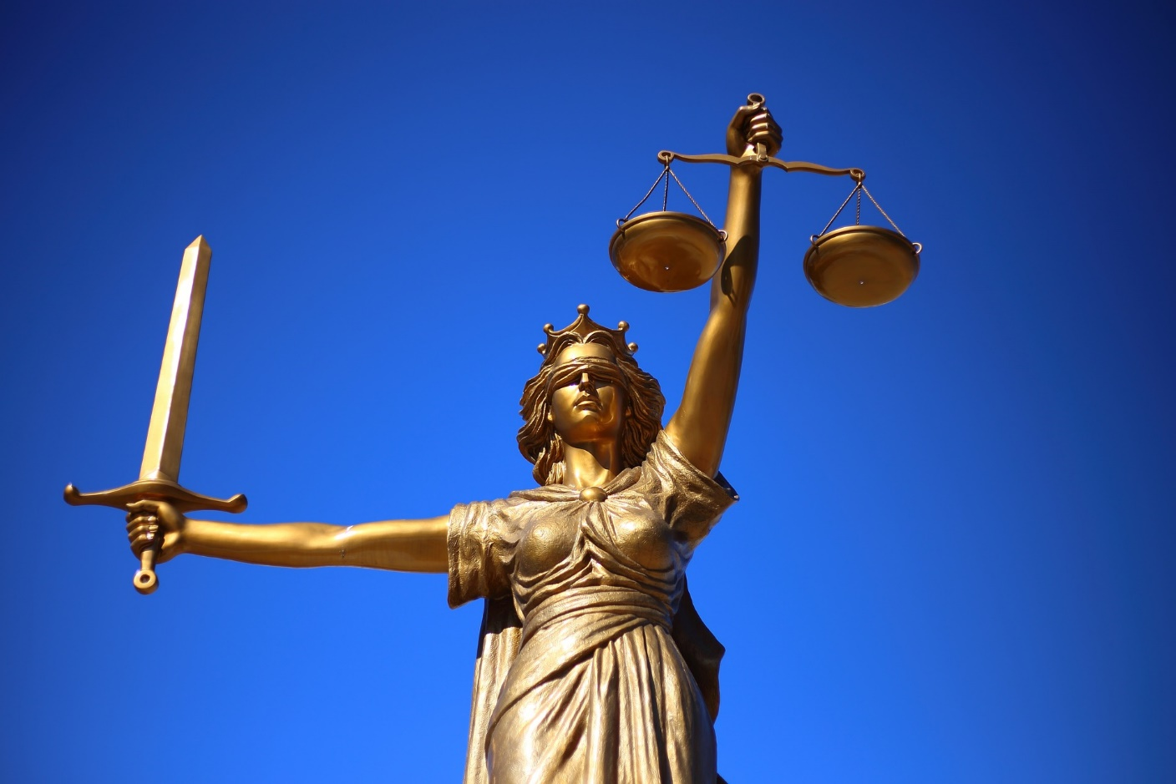
What is fair?

Slide 39
GDPR 2016/679 71)
[…] In order to ensure fair and transparent processing […], the controller should use appropriate mathematical or statistical procedures for the profiling,

Slide 40
GDPR 2016/679 71)
[…] and that prevents, inter alia, discriminatory effects on natural persons on the basis of racial or ethnic origin, political opinion, religion or beliefs, […] or that result in measures having such an effect.

Slide 41
«high risk»: 2/3 chance of being rearrested after two years («predictive parity»)
Courtland: “The bias detectives"
Nature, vol. 558 (2018)

Slide 42
3/10 and 2/3 of high risk group are rearrested
6/10 and 2/3 of high risk group are rearrested

Slide 43
1/7 = 14 % incorrectly
classified as high risk
2/4 = 50 % incorrectly
classified as high risk
false positives are more likely
in this group

Slide 44
as long as the members of the two groups are rearrested at different rates, it is difficult to achieve
predictive parity («2/3 of high risk group rearrested»)
and
equal false-positive rates

Slide 45
mathematically impossible
to satisfy
predictive parity
and
equal false-positive rates
and
equal false-negative rates

Slide 46
universal fairness is impossible
help!

Slide 47
COMPAS – Correctional Offender Management Profiling for Alternative Sanctions
Dressel and Farid: "The accuracy, fairness, and limits of predicting recidivism." Science Advances 4.1 (2018)

Slide 48
COMPAS: calibrated probabilities
Critics: false positives/
negatives

Slide 49
key challenge #4
we must agree on what is fair
+ how to audit AI?

Slide 50
reason #5:
artificial intelligence finds the shortest path

Slide 51
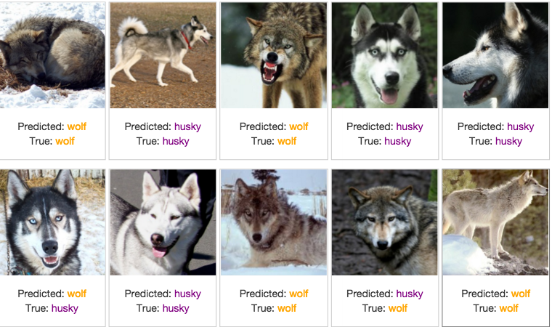
"Why Should I Trust You?“ Marco Ribeiro, University of Washington

Slide 52
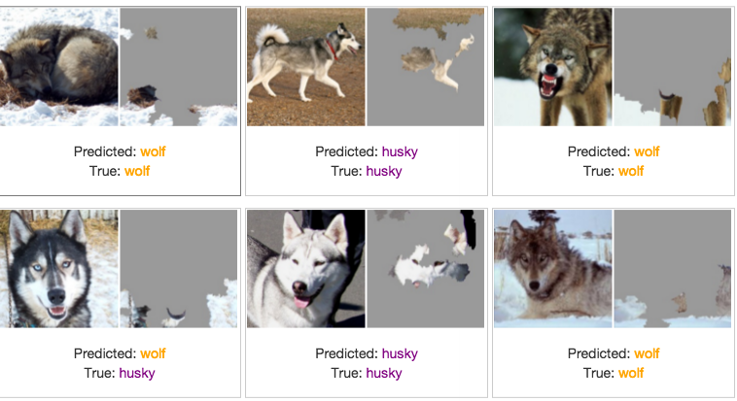
A snow
predictor!

Slide 53
key challenge #5
AI is a vehicle for prediction,
science needs causality

Slide 54
#1 not games
#2 bad data
#3 black boxes
#4 unfair models
#5 shortcuts

Slide 55
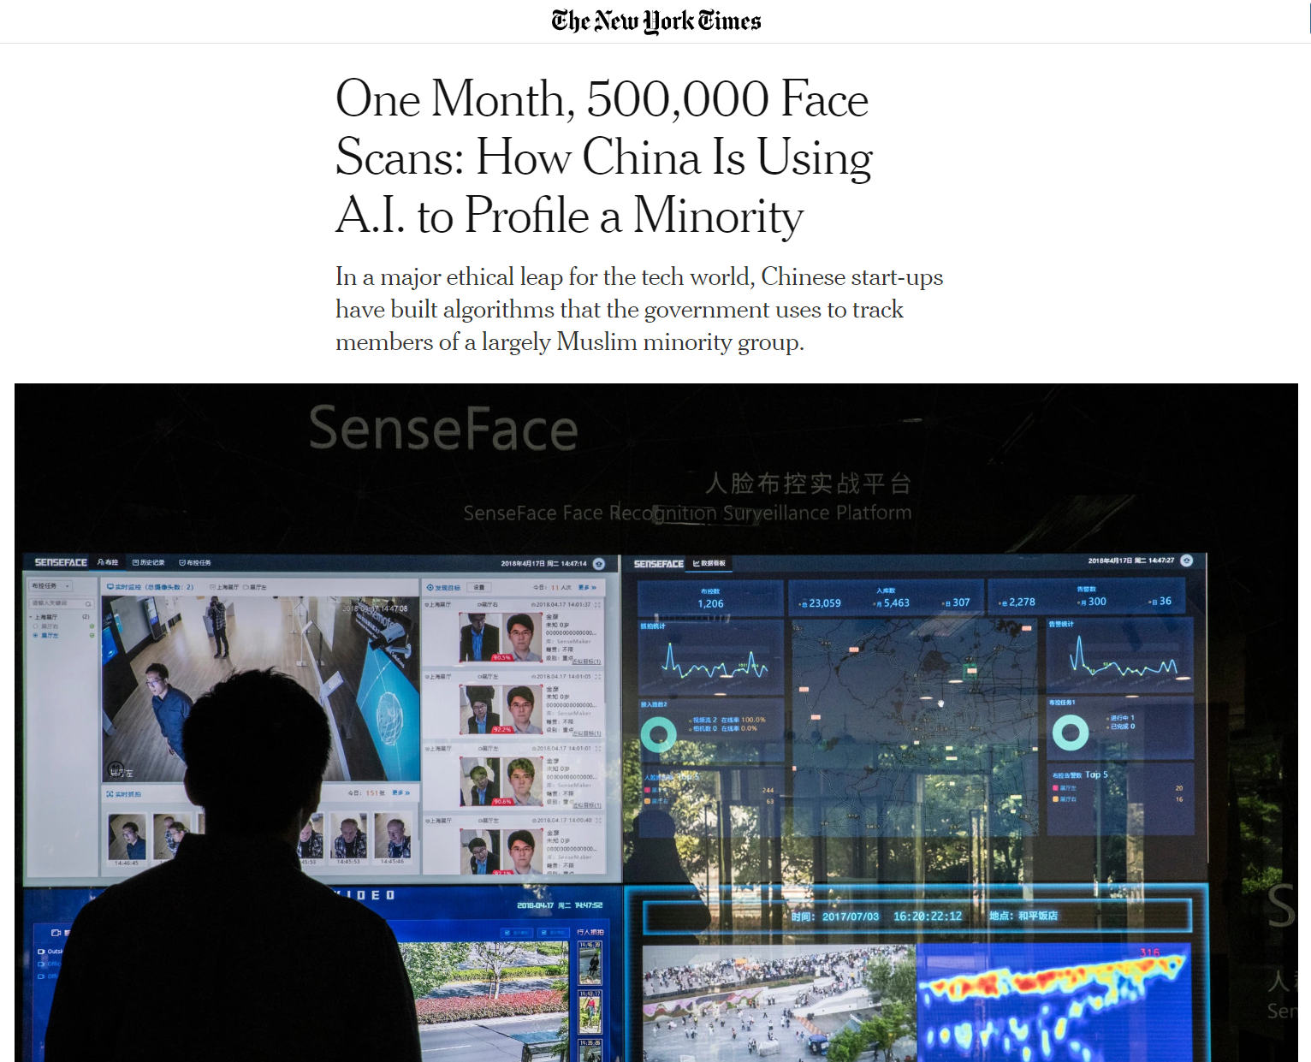

Slide 56
is privacy
good or bad
for AI research?

Slide 57
claim:
AI algorithms need lots of personal data

Slide 58

industrial data do not have privacy

Slide 59
explainable AI needs lot of CPUs/GPUs,
not lots of data

Slide 60
“Enter through the narrow gate. For wide is the gate and broad is the road that leads to destruction, and many enter through it. But small is the gate and narrow the road that leads to life, and only a few find it.”
Matthew 7:13–14

Slide 61
this is the broad road;
responsible AI will prevail in the long run

